Slide 1
Connecting the dots through different technology platforms
Joe Contini
Abt Associates, SHOPS
Monday, May 5th, 2104

Slide 2
The Interoperability Challenge
Interoperability is a combination of…
Data
Technologies
Organizations

Slide 3
Our challenge in Ghana
Licensed Chemical Sellers (LCS) are the front line for families seeking health care in Ghana.
To insure the quality of health advice provided, the LCS Association needed information:
Which LCS were selling non-recommended treatments and why
What problems did LCS face in providing appropriate medicines
What were their knowledge gaps, what additional training was needed
The solution: provide supervisors with mobile tools to collect, analyze and organize data

Slide 4
Lego Pieces
‘Final’ requirements change as more possibilities are imagined. We plan that we will need to keep building as more features are requested.
Tools that can be used as Lego pieces all have one thing in common: An API (Application Programming Interface)
As a result, we eliminate manpower needed to turn data into action for real impact.

Slide 5
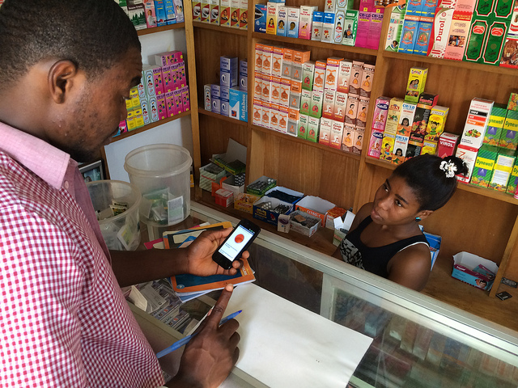
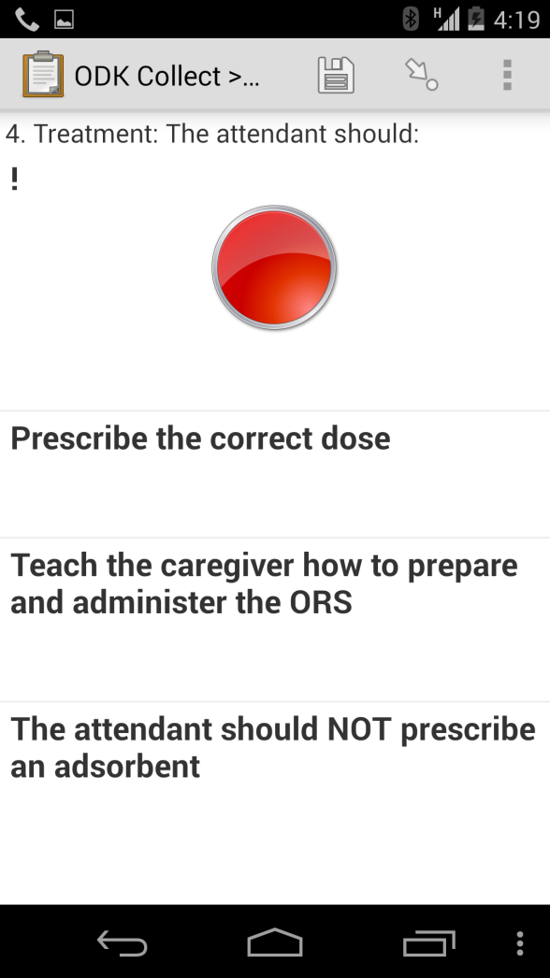
Part 1: The Smartphone

Slide 6
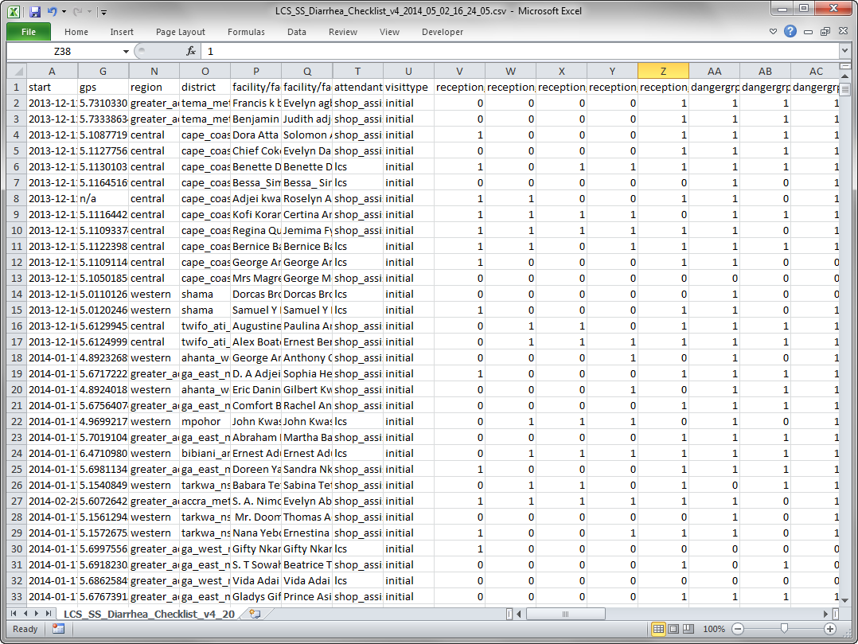
Part 2: The Raw Data

Slide 7
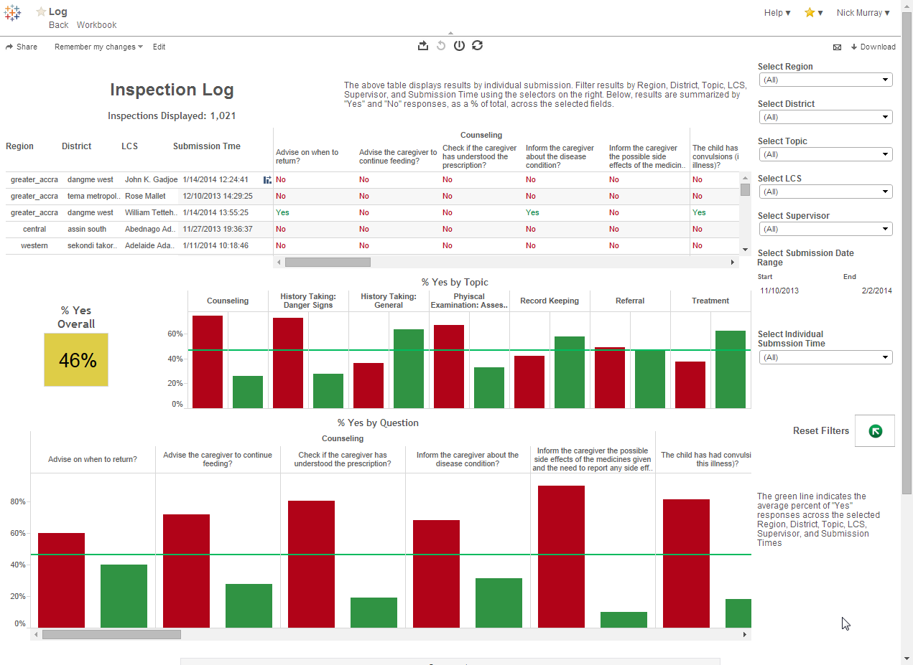
Part 3: The Dashboard

Slide 8
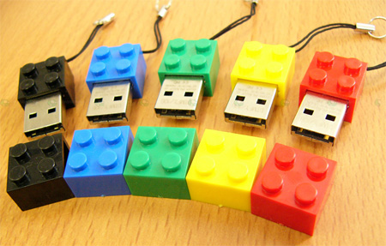
The End Game
Part 4: Association wants automatic emails triggered when thresholds not met
Part 5??
Part 6 ???
Part 7 ?????
Interoperability allows solutions to continue evolving, fixing problems in the future that you don’t know you have in the present.

Slide 9
Thank you for your time!

