Slide 1
Expanding Access to Injectable Contraceptives through Pharmacies in [insert country
Insert presenter name(s)
Insert date
Photo credit: Todd Shapera

Slide 2
[Insert goals and objectives of this presentation]
Photo credit: SHOPS Project

Slide 3
[Insert country] made FP2020 commitments. [insert country goal from http://www.familyplanning2020.org/entities]
In [insert country], unmet need for family planning is [insert percentage from DHS]
Injectables are a common method and are used by [insert percentage from DHS] women
The private sector is an important source of modern FP methods. [Insert percentage from DHS] of women obtain their method from a private pharmacy or drug shop
Photo credit: Jessica Scranton

Slide 4
In [insert country], DMPA-IM [is/is not] on the Essential Medicines List.
DMPA-SC [is/is not] on the Essential Medicines List
Pharmacists in [insert country] [are able/ not able] to sell injectable contraceptives
Currently, policies in [insert country] [permit/ do not permit/ are silent on] the administration of injectables through pharmacies
Photo credit: Jessica Scranton

Slide 5
Key Messages
Pharmacies are often the first entry point into the health system and are often more accessible than health facilities
Pharmacists often have more education and clinical experience
Expanding access to pharmacies alleviates strain on other service providers
Aligns with WHO recommendations
9 million more women could potentially access injectables through the private sector
Photo credit: Jessica Scranton

Slide 6
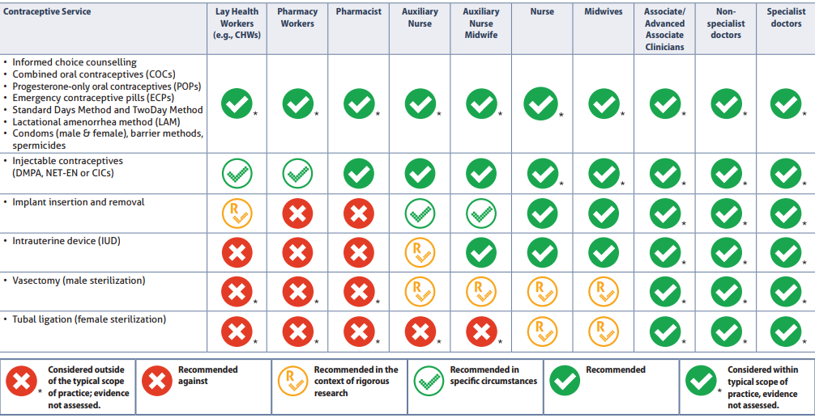
Establishing Global Consensus: WHO Task Sharing Guidance
Source: WHO. 2017. Task sharing to improve access to family planning/contraception. Geneva: WHO.

Slide 7
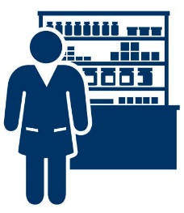
Task Sharing in Practice
Administration of DMPA-IM by CHWs been rigorously evaluated and has been endorsed by various stakeholders, including the WHO, World Bank, UNFPA, and USAID World Health Organization,
U.S. Agency for International Development, Family Health International (FHI). Community-Based Health Workers Can Safely and Effectively Administer Injectable Contraceptives: Conclusions from a Technical Consultation. Research Triangle Park (NC): FHI; 2010
[If possible, insert evidence from your country]
Three countries have attained waivers for drug shops pilots : Bangladesh, Nigeria, Uganda
In Uganda, training of drug shop operators in DMPA-IM resulted in high client satisfaction (73 percent)
Akol, Angela, Dawn Chin-Quee, Patricia Wamala-Mucheri, Jane Harriet Namwebya, Sarah Jilani Mercer, and John Stanback. "Getting closer to people: family planning provision by drug shops in Uganda." Global Health: Science and Practice 2, no. 4 (2014): 472-481

Slide 8
Leveraging [insert association name]
[Highlight the strengths of your association and what you can bring to the table]

Slide 9
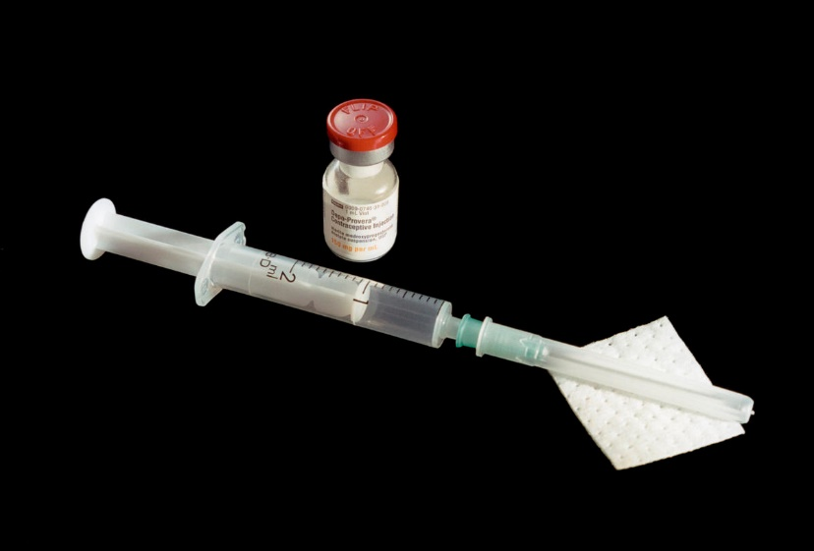
Ensuring Quality and Safety
[highlight what your association can do to ensure quality services and prevent abuse of the practice]

Slide 10
Monitoring Progress
[highlight what your association can do to assist pharmacies in routine reporting. Consider which tools pharmacies can use to report their services and how those tools will be collected from pharmacies to existing reporting systems]

Slide 11
Taking Action
[highlight the steps your association could take to continue the conversation to achieve progress]

Slide 12
Thank you!
[Insert name]
[Insert contact information]

