Slide 1
Sindh Family Planning Market Description
Pathfinder Pakistan
June 2023

Slide 2
PURPOSE
01
Overview
Provide an overview of the family planning market in Sindh province of Pakistan.
The purpose of this preliminary Market Description is to…
02
Market Performance
Understand who is being served by the market and who the market is failing.
03
Opportunities for the Private sector
Understand who is delivering family planning information and services and to whom with a focus on private sector.
04
Identifying Customized Solutions
Facilitate common understanding of the family planning landscape, key market function constraints, and identify opportunities for increasing access to and uptake of family planning services through private sector.

Slide 3
OUTLINE
01
Key Market Constraints
A summary of key constraints identified by market function using the AIM framework
05
Use-Need Analysis
An analysis of Contraceptive Use, family planning users, intenders, and non-intenders, by spacing and limiting
Strategic Logic Model
An initial set of market interventions based on market description information, discussions with key informants and experiential inputs.
02
06
FP Quality & Discontinuation
Assessment of FP counseling quality and Discontinuation by method and reasons
03
National Context
Family planning, FP2030
07
Assessment of Supply
Trends in service delivery, sources of methods and Information, and messages received, and sources of family planning services
04
Sindh Landscape
Social, demographic and health indicators, Fertility, and Fertility Management trends, Desire for Fertility

Slide 4
1. Key Market Constraints A summary of key constraints identified by market function using the AIM framework

Slide 5
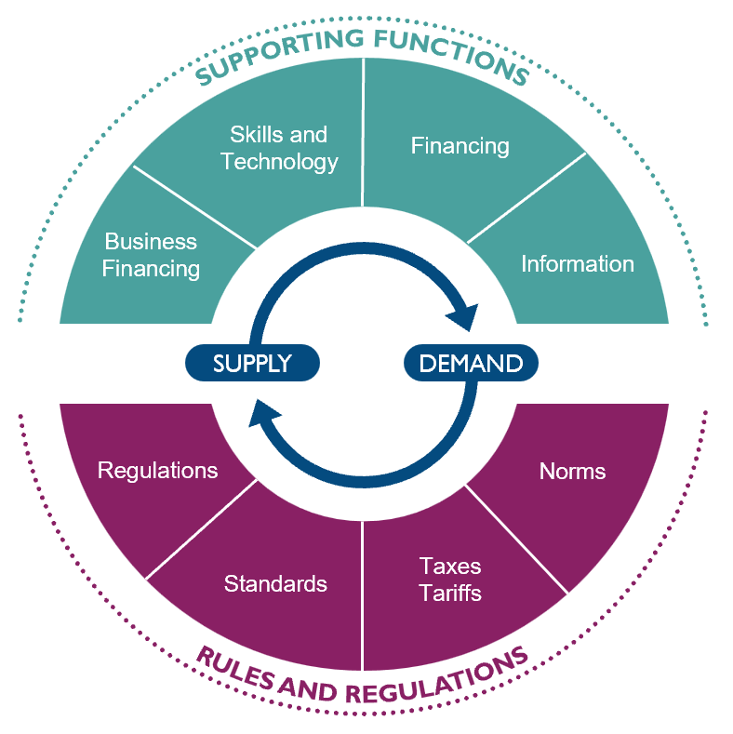
Key Market Constraints AIM Analysis for market system performance for Family Planning in Sindh Pakistan
CORE MARKET | A Absent | I Inadequate | M Missing | Observations
Core Market |  | X |  | SUPPLY FRAGMENTATION OF SUPPLY by sector, residence, and source: Minimal supply of FP Products and Services from urban private health facilities, bulk of services through pharmacies and retail shops. Method mix is skewed with predominantly Condoms and Female Sterilization; particularly in urban areas and upper wealth quintiles which are served by private/Commercial sector. Little to no focus on ECP, OCP, and Injectables across the operating context. Limited availability of full method mix in urban areas and from private providers in Rural Areas. Pills and injectables are the only locally manufactured methods, LARCs and condoms are import-based. LACK OF SERVICES FOR YOUTH Supply forecast and strategies only geared towards addressing unmet need among married women of reproductive age. Restricted access for young people and unmarried consumers. LIMITED AND FRAGMENTED SUPPLY OF FP INFORMATION fragmented digital supply in a thriving online marketplace. >60% facility births, but low PPFP and PAFP service offering, particularly in large urban facilities.

Slide 6
Key Market Constraints AIM Analysis for market system performance for Family Planning in Sindh Pakistan
CORE MARKET | A Absent | I Inadequate | M Missing | Observations
Core Market |  | X |  | DEMAND FAILURE TO CRYSTALLIZE DEMAND High prevalence of traditional method users and non intenders, High level of perceived health risk, and persistent normative barriers (religion and household opposition) FAILURE TO FACILITATE ACTION BY INTENDERS Ability to pay, Low financial autonomy, not talked about FP during health facility/field worker visits, Limited effectiveness and investments in behavior change campaigns. HIGH RATES OF DISCONTINUATION(30%) due to poor counseling, adverse effects of LARCs, and poor technical quality of care.

Slide 7
Key Market Constraints AIM Analysis for market system performance for Family Planning in Sindh Pakistan
Market characters |  |  | A | I | M | Observations
SUPPORTING FUNCTIONS | Financing | S & D |  | X |  | LACK OF PRIVATE SECTOR INTEREST in LARCs and FP generally. Public sector services free but focus on rural areas. Mostly donor dependent and SMO led initiatives focusing on condoms and/or LARCs. HIGH OUT OF POCKET COST for day-care, outpatient services, maternity and FP by private providers, not covered under public sector insurance programs in other provinces.
 |  | Subsidies | X |  |  | LIMITED PUBLIC SECTOR SUPPLY OF CONTRACEPTIVES to non-profit private sector
 |  | Business |  |  | X | COMPETITION of public sector supplied commodities with private sector sales. UNFAVORABLE REGULATIONS and low business investments by private sector for health care services.
 | Info | Supply | X |  |  | UNDERESTIMATION OF DEMAND Unmarried Women of Reproductive Age not counted in Demand calculation. NO DATA from for profit private sector and Discrepancies between distribution & DHS prevalence data.
 |  | Demand |  | X |  | LIMITED AVAILABILITY OF DATA on consumer perceptions and beliefs, including counseling for QoC. NO DATA on perceptions or beliefs from Users.
 | Skills, Capacity |  |  | X |  | POOR CLINICAL AND BEHAVIORAL COMPETENCE of providers, particularly for LARCS; and long-standing issues have led to widespread fears of side effects. LIMITED INCENTIVES & OPPORTUNITIES for capacity development. Widespread non-compliance with existing licensing standards.
 | Stewardship |  |  | X |  | NO CLEAR STEWARDSHIP ROLES defined for private sector; widespread fragmentation and lack of coordination across the commercial sector, with competition between the commercial and development sector. No channels of communication created between commercial and development sector. Lack of collaborative engagement with professional associations. PLATFORMS FOR DIALOGUE Public-Private: Sindh CIP Sub-Groups on themes: e.g., Quality and Adolescent & Youth (AY) with limited scope and pace of work. Private-Private: Impact Hub, only FP NGOs are members.

Slide 8
Key Market Constraints AIM Analysis for market system performance for Family Planning in Sindh Pakistan
Market characters |  |  | A | I | M | Observations
RULES AND REGULATIONS | Regulations |  |  |  | X | LACK OF REGULATORY MECHANISMS for private sector providers. SERVICE DELIVERY RESTRICTIONS on Cadres for Implant removal. PRODUCT REGISTRATION taking longer generally 1.5 to 02 years, very slow process impacting organizational plans launching new FP brands SINGLE SOURCE MANUFACTURER IMPORT REGULATION restricting companies to import products from one/similar manufacturer (if one Pakistani company getting products from company X then no other company can purchase from this particular company and have to find another manufacturer). This issue has further challenges as this regulation also restricting to buy only from WHO qualified or ISO certified (CE) manufacturer which makes purchasing choices even harder)
 | Tariffs, Taxes |  |  |  | X | GENERAL SALES TAX AND CUSTOM DUTY impacting significantly on condom brands (more specifically) and we know condoms has the second popular method (market share) in Pakistan COST OF DOING BUSINESS has risen dramatically given the current inflation and dollar fluctuation. Given this situation controlling prices and making it feasible for clients have become an ongoing serious challenge IMPORT ISSUE due to dollar shortage, letter of credits are not opening or delayed which impacting import of FP products
 | Standards |  |  |  | X | NO INCENTIVES or regulatory imperatives for private sector provision of FP services except tubal ligations which are incentivized by public sector.
 | Norms | Supply | X |  |  | BEHAVIORAL COMPETENCE (bias against young people, FP generally, and towards LARCs); Lack of norms for person centered care among private sector providers. Private sector providers’ LOW MOTIVATION to offer services and report data and information for FP
 |  | Demand | X |  |  | LACK OF DESCRIPTIVE NORMS for consumers to support demand mobilization. Unfavorable community and gender NORMS.

Slide 9
2. STRATEGIC LOGIC MODEL FOR SINDH An initial set of market interventions based on market description information, discussions with key informants and experiential inputs.

Slide 10
Vision and Market Entry Points SINDH FAMILY PLANNING MARKET
5 “Ps” | Descriptions
PEOPLE | Adolescents and youth Women and Girls of reproductive age Men
PRODUCTS / SERVICE | ECP Injectables Condoms Pills
PRICE | Current market prices need to be better understood from consumer and supplier perspectives. Pricing for services through pharmacies cover service charges
PLACE | Urban commercial and social sector providers and facilities Pharmacies & Drug shops Digital marketplace & Telehealth Networks
PROMOTION | Digital and social media Youth Led Organizational (YLO) Networks During healthcare encounters with commercial sector providers Integrated into ante-natal care for PPFP
FHM Engage 3 Year Vision Sindh PK
Strengthened health markets for short term contraception in urban Sindh through expanded availability of integrated FP/RH services delivering high quality information, products, and services for family planning which respond to youth driven demand.

Slide 11
Strategic Logic Model For Strengthening Family Planning Markets in Sindh PK
IMPACT: Improved Health Outcomes
Reduced maternal mortality and morbidity & reduced neonatal mortality
OUTCOMES: Increased access to improved FP at affordable costs
Increased adoption and method adherence for short-term methods among women of reproductive age
Increased consumer driven demand for FP and short-term contraceptive information, products, and services
Improved availability, affordability, and appropriateness (technical and behavioral quality) of FP care & ST methods through a range of urban sector provider and provider networks from social and commercial sectors
Improved Stewardship and coordination of FP markets and FP quality focusing on FP quality, expanding short term method contraceptive market, and improving youth driven demand.
Improved market intelligence of need and demand by inclusion of all WRA
Strengthened Rules and market intelligence for supporting private health sector compliance with FP quality standards to deliver person-centered FP care delivered by private health providers
Access to FP Care expanded through market-based solutions for improved engagement of for-profit health sector including for profit health networks, pharmacies, retail shops, and informal providers. FP care delivered through pharmacies and retail shops strengthened and linked to continuum of care.
Family planning messages disseminated creatively and frequently as a cross-cutting theme through mass media, particularly television
Digital investments leveraged for improved access to FP information, products, and services
Men are mobilized and supported in championing FP and women’s agency to choose FP.
OUTPUTS: Improved performance of mixed health markets in Sindh
INPUTS: Market Interventions

Slide 12
INPUTS: Market Interventions For Strengthening Family Planning Markets in Sindh PK
Strengthen local platforms for private sector and public-private dialogue to strengthen contraceptive Market supply, improve Rules for FP quality, and strengthen youth-driven demand.
Leverage investments in SMOs for multi-lateral collaborations to expand FP markets for short-term methods to for-profit hospitals/hospital networks and laboratory networks.
Explore and test FP service delivery models including for men, for Pharmacy, Retail store-based, and traditional service providers.
Collaborate with Sindh Healthcare Commission (SHC) and local market actors to integrate and implement FP standards in quality assessment of private providers for licensing.
Digital FP Marketplace for demand aggregation and leveraging existing infrastructure and investments.
Facilitate GoS in implementing media engagement strategy through private sector partners for creating salience of FP and Sindh Narrative on Population
Community-based campaigns aimed at men for building social salience of FP
Improved market intelligence by: Market survey among consumers of for-profit services, for profit providers, advocacy for inclusion of Unmarried WRA in collaboration with NIPS, POP Council, PAP, PBS, etc.

Slide 13
3. National Context A summary of the overall national landscape related to Family planning and FP2030 commitments

Slide 14
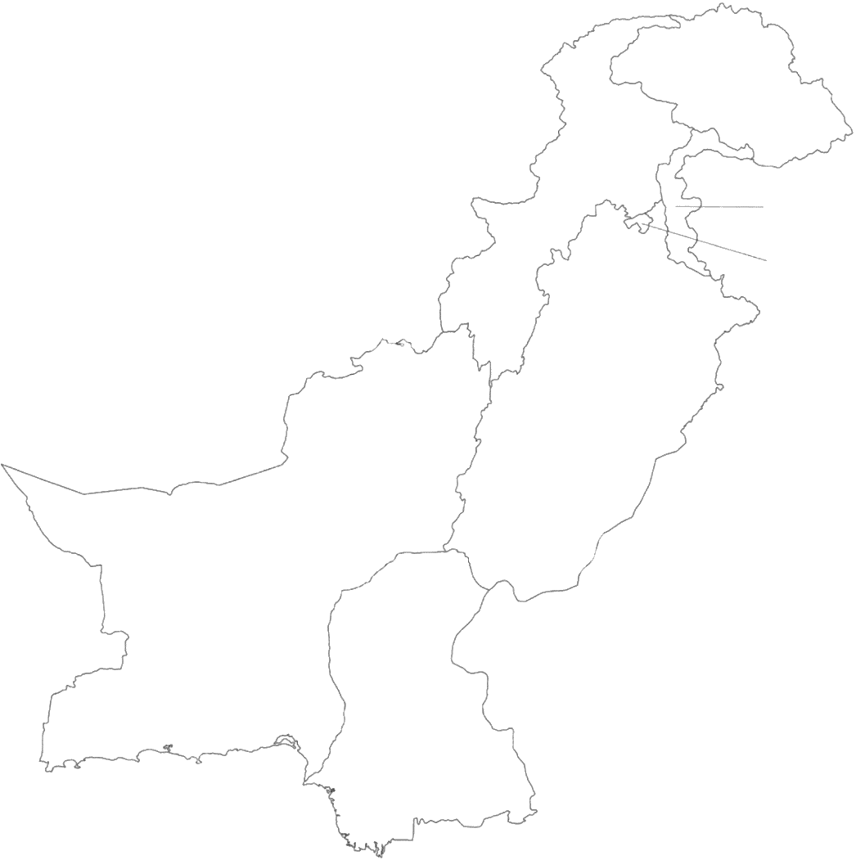
Low contraceptive use across the country
The national modern CPR stands at 25% (Sindh: 24%) with 9.6 million (Sindh: 2.4 million) MWRA using modern FP methods.
Population
No. of Users
mCPR
Gilgit
Baltistan
(GB)
7.8 million
0.4 million
30%
39.8 million
1.5 million
23%
Khyber
Pakhtun-khwa
Azad Jammu & Kashmir (AJK)
PAKISTAN
249.6 million
10 million
25%
Islamabad Capital Territory (ICT)
Punjab
127.4 million
5.5 million
27%
21.9 million
0.5 million
14%
Balochistan
Sindh
57.9 million
2.5 million
24%
*Separate population estimates for ICT, GB, & AJK currently not available
Data sources: Digital Census 2023 (As of April 30th) & PDHS 2017-18

Slide 15
CPR is not tracking to achieve FP 2030 commitments
The national FP2030 commitment is to raise the CPR from 34% to 50% by 2025 and to 60% by 2030 while the provincial commitment for Sindh is to raise the CPR from 30% to 47% by 2025 and to 57% by 2030.
Data sources: FP2030

Slide 16
National FP 2030 Commitments - Objectives
Adapt and implement evidence-based progressive policy reforms with political will and enabling environment at all levels
Universal access to services to lower fertility rates and address unmet need for contraception
Addressing information and service needs specially to remote areas
Gearing for Uniform Understanding of National Narrative
Contraceptive commodity security and efficient supply mechanism
Legislative Support
Institutionalization of human development and system strengthening to sustain FP efforts
Monitoring and evaluation for results and effectiveness
Financial Commitment Objective: Mobilizing Funds and Allocations for FP/RH activities

Slide 17
4. SINDH LANDSCAPE Social, demographic and health indicators, Fertility, and Fertility Management trends, Desire for Fertility

Slide 18
SINDH: An Overview of the Context
MCH INDICATORS | A
Child Health coverage
Childhood stunting | 49.9
Immunization coverage | 49%
Children receiving age-appropriate vaccination | 32.7%
Women’s access to healthcare
Percentage Women accessing healthcare | 54%
Antenatal care coverage (4+ visits) | 44.3%
Deliveries in healthcare facilities | 71.8%
Demand for family planning satisfied | 44.3%
Not wanting to go alone to a health facility | 46%
Women not allowed by family members due to cost of services and social norms | 10%
Performance Metrics
Access Index | 79.2/100
Quality Index | 58.1/100
Service Coverage Index | 48/100
SOCIO-DEMOGRAPHICS | A
Total Population | 58 million
Population Growth Rate | 3.1%
Urban Population | 52%
Calamity-affected districts | 23/30
GDP per Capita | $ 1,748
Health expenditure - % of GDP | 2.5
MCH OUTCOMES | A
Pregnancy-related deaths | 345 per 100,000
Maternal mortality ratio | 224 per 100,000
Under-5 Mortality | 77 per 1,000 56 (Urban)/93(rural)
Data sources: WHO Vital Signs Report (2022)

Slide 19
Total fertility rate declined over time
Total Fertility Rate (TFR) in Pakistan and Sindh has steadily (if slowly) declined from 4.9 and 4.5, respectively, to 3.6 births per MWRA.
Data sources: PDHS 2017-18

Slide 20
61% MWRA indicating a need for spacing or limiting
61% MWRA either want no more children, want a child after two years, or are unsure about when they want to have next their child indicating a strong latent demand for family planning.
Data sources: PDHS 2017-18

Slide 21
Desire to limit fertility increases with the number of children
21% MWRA with two children and 52% MWRA with three children want no more children. The desire to limit fertility becomes strong after the fourth child with more than 70% MWRA with four, five, and six plus children wanting no more children.
Data sources: PDHS 2017-18
21

Slide 22
Breaking down DEMAND for FP in Sindh
48% MWRA have a need for FP: 29% of MWRA report a need for limiting, while19% MWRA report a need for spacing. 52% report having no need for FP (are pregnant, intend to get pregnant, or do not want to limit/space births).
Data sources: Digital Census 2023 (As of April 30th) & PDHS 2017-18

Slide 23
The mCPR in Sindh has remained relatively stagnant since 2006-07
In line with national trends, just over 10% of women continue to report history of induced abortion for fertility management, since 2012-13.
mCPR
History of
Induced Abortion
Traditional Methods
Data sources: PDHS 1990-91, 2006-07, 2012-13, 2017-18

Slide 24
Method mix has remained consistent over time
Sterilization and condoms drove contraceptive use for MWRA in 1991 and 2018; Oral Pills and Injectables made modest contributions to the method mix from 2013, while LARCs (IUDs and Implants) accounted for less than three percent of mCPR in 2017-18.
Data sources: PDHS 2017-18

Slide 25
5. SINDH A Use/Need Analysis of Contraceptive & Family Planning Markets

Slide 26
Approach to understanding the market
Who the Market is Serving
Demand
Intention
Use
Number of Married Women of Reproductive Age (MWRA) with a need for FP
Number of MWRA who intend to use modern FP methods or use traditional methods
“Intenders”
Number of MWRA who currently use modern FP methods
“Users”
Who the Market is Failing
Number Unmarried Women of Reproductive Age with a need for FP
Number of MWRA who do not intend to use any FP methods
“Non-Intenders”
Number of MWRA projected to discontinue method in 12 months
“Discontinuers”

Slide 27
The demand for FP in Sindh is under-estimated at 5 million MWRA of which ~50% of the demand is met with modern FP, with over 2.5 million MWRA living with unmet need for FP.
Who the Market is Serving
Demand
Intention
Use
5 million
Number of Married Women of Reproductive Age (MWRA) with a need for FP
1.4 million
Number of MWRA who intend to use modern FP methods or use traditional methods
“Intenders”
2.5 million
Number of MWRA who currently use modern FP methods
“Users”
Who the Market is Failing
>3 million
Number Unmarried Women of Reproductive Age
Need for contraception not calculated & not included in Demand estimates
1.1 million
Number of MWRA who do not intend to use any FP methods
“Non-Intenders”
0.8 million
Number of MWRA projected to discontinue method in 12 months
“Discontinuers”
Data sources: Digital Census 2023 (As of April 30th) & PDHS 2017-18

Slide 28
2.5 million MWRA currently using FP in Sindh
With an mCPR of 24% and 50% demand for FP satisfied, there are approximately 2.5 million MWRA currently using modern contraceptive methods in Sindh. 2.5 million MWRA have a need for FP of which only 34% (1.4 million) intend to use modern FP in the future.
DEMAND AND USE
Total MWRA | 5 million
Using | 2.5 million
UNMET NEED
Total MWRA | 2.5 million
Intenders | 1.4 million
Data sources: Digital Census 2023 (As of April 30th) & PDHS 2017-18

Slide 29
Of the 1.9 million MWRA with a need for limiting, 64% are using a modern FP method
MWRA with need for limiting are older with average age >35 years; 54% are sterilized, while 33% of the MWRA not using are intending to use in the future. 37% of the users and 34% of the non-users report a history of induced abortion.
LIMITING
Total MWRA | 3 million
Mean Age | 36
LIMITING – USERS
Total MWRA | 1.9 million
History of Induced Abortion | 37%
LIMITING – NON-USERS
Total MWRA | 1.1 million
History of Induced Abortion | 34%
Data sources: Digital Census 2023 (As of April 30th) & PDHS 2017-18

Slide 30
Of the 2 million MWRA with a need for spacing, 30% are using a modern FP method
MWRA with need for spacing are younger with average age >28 years; 56% are condoms, while 55% of the MWRA not using are intending to use in the future. 43% of the users and 57% of the non-users report a history of induced abortion.
SPACING
Total MWRA | 2 million
Mean Age | 28
SPACING – USERS
Total MWRA | 0.6 million
History of Induced Abortion | 26%
SPACING – NON-USERS
Total MWRA | 1.4 million
History of Induced Abortion | 28%
Data sources: Digital Census 2023 (As of April 30th) & PDHS 2017-18

Slide 31
Users – Method Mix Disaggregated by Age
Limited use amongst young people with less than 50,000 users. Skewed method mix for 15-19 and 30-49 aged MWRA. Predominantly Condoms and Sterilization.
Age | mCPR | USERS
15-49 | 24% | 2.5 m
30-49 | 30% | 1.8 m
20-29 | 18% | 0.6 m
15-19 | 8% | 0.05 m
Data sources: Digital Census 2023 (As of April 30th) & PDHS 2017-18

Slide 32
Users – Method Mix Disaggregated by Residence
Skewed Method Mix in urban areas. Predominantly Condoms and Female Sterilization.
 | mCPR | USERS
Sindh | 24% | 2.5 m
Urban | 27% | 1.6 m
Rural | 20% | 0.9 m
Data sources: Digital Census 2023 (As of April 30th) & PDHS 2017-18

Slide 33
Users – Method Mix Disaggregated by Wealth
Skewed Method Mix, particularly in upper wealth quintiles: Predominantly Condoms and Female Sterilization.
 | mCPR | USERS
Sindh | 24% | 2.5 m
Highest | 32% | 0.4 m
Fourth | 26% | 0.4 m
Middle | 31% | 0.6 m
Second | 23% | 0.5 m
Lowest | 19% | 0.7 m
Data sources: Digital Census 2023 (As of April 30th) & PDHS 2017-18

Slide 34
Intention to use modern FP by Age
20-29 aged MWRA have the highest proportion (38%) of intenders while the 30-49 aged MWRA have the highest market size for intenders (0.7 million).
Age | TOTAL
15-49 | 1.4 m
30-49 | 0.7 m
20-29 | 0.6 m
15-19 | 0.1 m
Data sources: Digital Census 2023 (As of April 30th) & PDHS 2017-18

Slide 35
Intention to use modern FP by Geography
Urban MWRA have the higher proportion (39%) of intenders and the larger market size as well (0.9 million).
Residence | TOTAL
Overall | 1.4 m
Urban | 0.9 m
Rural | 0.5 m
Data sources: Digital Census 2023 (As of April 30th) & PDHS 2017-18

Slide 36
Intention to use modern FP by Wealth
Fourth wealth quintile has the highest proportion (40%) of intenders while the lowest wealth quintile has the largest market size (0.5 million).
 | TOTAL
Sindh | 1.4 m
Highest | 0.2 m
Fourth | 0.2 m
Middle | 0.2 m
Second | 0.3 m
Lowest | 0.5 m
Data sources: Digital Census 2023 (As of April 30th) & PDHS 2017-18

Slide 37
Predictors of Intention and Use
High prevalence of unfavorable predictors of intention (personal opposition, potentially driven by fear of side-effects, opposition from husband, religious prohibition, and agency to spend) amongst non-intenders compared to intenders.
Lack of access/distance to and cost of FP services are primary barriers to adoption of FP by intenders
 | PREDICTORS OF INTENTION |  |  |  |  | PREDICTOR OF USE
Correlation with Intention | Unfavourable Attitude | Restrictive Perceived Norm |  | Agency to Spend |  | Environmental Constraints
Correlation with Intention | -0.4* | -0.2* | -0.4* | 0.3* | 0.3* | 0.4* | 0.4*
Data sources: PDHS 2017-18

Slide 38
6. FP Quality & Discontinuation Assessment of FP counseling quality and Discontinuation by method and reasons

Slide 39
Quality of Care: Method Information Index (MII)
The MII is a three question index that summarizes whether service providers supply adequate information to women when receiving family planning (FP) services
41% of current users were told about none of the three MII indicators with only 21% informed about all three. 66% users reported being told about how to deal with side effects, 50% were told about other FP methods, and 37% were told about side-effects.
Sources: PDHS 2017-18

Slide 40
1-year discontinuation rate of 30% due to poor counseling, adverse effects of LARCs, and poor technical quality of care
Methods Discontinued in the Last Five Years
Reasons for Discontinuing Method
Sources: PDHS 2017-18

Slide 41
7. SINDH ASSESSMENT OF SUPPLY Trends in service delivery, sources of methods and Information, and messages received, and sources of family planning services

Slide 42
The National Healthcare System
FP services are largely provided through the first and second administrative levels in the healthcare system i.e., public and non-profit private Mid-level healthcare providers operating at the Community and Union Council levels.
Sources: WHO Vital Signs Report (2022)

Slide 43
34,070 private sector service delivery units in Sindh Implants: 15% of users served by NGOs and private facilities. IUDs: 29% of users served by NGOs and private facilities. Injectables: 25% of users served by NGOs and private facilities, 2% by dispenser/pharmacy, and 4% by informal sector. Pills: 12% of users served by NGOs and private facilities, 22% by pharmacies, and 19% by retail shops. Male condoms: 3% of users served by NGOs and private facilities, 34% served by pharmacies, 48% by retail shops
Sources: WHO Vital Signs (2022), Private Sector Landscape Assessment for FP (2016), Provincial Assembly Sindh (2019)

Slide 44
SINDH: Complex FP Commodity Flow
Sindh government procures FP commodities from national and international suppliers through PWD
Private sector procures FP commodities from national and international suppliers distributed onwards through their own supply chains.
PWD also supplies private sector stores through PWD district stores.
Sources: UN Commodities Security Report (2020)

Slide 45
Map of FP Private Sector Supply Chain Actors In Sindh
Policy & Guideline Development
MoNHSRC
MoPW & MoH
Importers, Wholesalers & Distributors
For Profit: Getz Pharma, Zafa, etc.
Social Marketing: Greenstar, MSS, DkT
Landscape of Market Actors in FP Product and Service Markets
Regulators
Drug Regulatory Authority
Sindh Healthcare Commission
Pakistan Medical & Dental Council, Pakistan Nursing Council, Pharmacy Council
Service Delivery Points
For profit Hospitals, private clinics, CMWs, Dispensers
NGO operated hospitals/clinics: MSS, FPAP,
Social Franchise: GSM, MSS, DkT, FPAP
Pharmacies
Retail Shops
Hakims, Homeopaths, and Dais
Financing
Min. of Planning & Dev.
Min. of Finance
Commodity Procurement & Distribution
Population Welfare Dept.
Dept. of Health
Professional Associations
Pakistan Medical Association
Pakistan Nursing Association & Federation; Paramedic Association; SOGP
APPMA, IMPACT HUB
Data Management
MoPWD & MoH
Pakistan Bureau of Statistics
Service Delivery Points
Health Facilities
Community outreach
Financing
Out of Pocket
FCDO, USAID, BMGF, UNFPA
Target Population
Implementing Partners
Pathfinder, GSM, PSI, MSS, DkT, FPAP, Chemonics, JSI, HANDS, Population Council,, NCMNH, AMAN, AKF, etc.
Married women of reproductive age (15-49 years)
Commodity Procurement
UNFPA, MSS, PSI, GSM, DkT, HANDS, FPAP
Advocacy, Coordination & Tech. Support
UNFPA, FCDO, USAID, BMGF
45

Slide 46
Sources and Types of FP Information for MWRA
More than 50% MWRA had visited a health facility or was visited by a fieldworker in the preceding year with 29% and 56% users discussing FP at the health facility or with the fieldworker, respectively. Messages on birth spacing, maternal and child health, and small family leads to prosperity garnered the highest retention amongst MWRA. Limited application of mass media sources for message dissemination.
Sources: PDHS 2017-18
46

Slide 47
SINDH: Public Sector Contraceptive Procurement Financing and Trends
Government of Sindh spent 15.7 million dollars (39%) of the planned 40 million dollars at 1.93 dollars per capita.
Public sector distribution of contraceptive commodities to districts in Sindh from 2012 to 2020 indicates that the procurement and dsitribution of condoms declined from 12 million units, pills from around 9 million units, and injectables from around 4 million units to less 2 million units per year.
FUNDS PLANNED AND SPENT
Department | Planned (in millions) 2014-19 | Expenditure (in millions) 2014-19 | Per Capita Spending 2014-19 | Percentage Spent of Planned 2014-19
PWD & DOH (Joint) | PKR 6,400 $ 40 | PKR 2,523 $15.7 | PKR 309 $1.93 | 39%
DISTRIBUTION TREND 2012 – 2020
Source: Landscape Analysis Of Contraceptive Commodity Security In Pakistan (2020)

Slide 48
SINDH – Public & Private Sector Contraceptive Service Delivery 2016 – 2021
Public sector outperformed the private sector in contraceptive service delivery from 2016-17 to 2019-20. In 2020-21, in response to COVID-19, government LHWs and providers were re-tasked to COVID-19 testing and screening units. The difference of 32 million services in 2020-21 largely stems from private sector’s provision of 42 million condoms. Moreover, no data from the for-profit private sector.
COVID-19
Sources: Annual Contraceptive Performance Report 2016-17, 2017-18, 2018-19, 2019-20, 2020-21

Slide 49
SINDH – Public & Private Sector Contraceptive Service Delivery 2016 – 2021 by Sterilization Cases
The market for female sterilization has been dominated by the public sector with an annual average of more than 30,000 cases while the private sector managed around 22,000 cases in five years. Akin to the market for female sterilization cases, the market for male sterilization cases is also dominated by the public sector, however, the volume of cases is extremely low with the public sector managing around 1900 cases over five years and the private sector managing 21 cases over five years.
COVID-19
Sources: Annual Contraceptive Performance Report 2016-17, 2017-18, 2018-19, 2019-20, 2020-21

Slide 50
SINDH – Public & Private Sector Contraceptive Service Delivery 2016 – 2021 by LARCs – IUDs
Private sector outperforms the public sector for IUDs with 0.3 million IUDs provided in the 2020-21 period, however, it should be noted that one out of every five MWRA using IUDs discontinue within a year.
1-year Discontinuation Rate for IUDs
23%
COVID-19
Sources: Annual Contraceptive Performance Report 2016-17, 2017-18, 2018-19, 2019-20, 2020-21, PDHS 2017-18

Slide 51
SINDH – Public & Private Sector Contraceptive Service Delivery 2016 – 2021 by LARCs – Implants
Public sector has served majority of the MWRA using implants; in 2020-21, the private sector provided around 7,000 implants while the public sector provided around 70,000 implants, nearly ten-fold more.
COVID-19
Sources: Annual Contraceptive Performance Report 2016-17, 2017-18, 2018-19, 2019-20, 2020-21

Slide 52
SINDH – Public & Private Sector Contraceptive Service Delivery 2016 – 2021 by Short-term Methods – Male Condoms
From 2016-17 to 2018-19, both public and private sectors provided around 30 million condoms. In the 2020-21 period, public sector provision drops due to 8 million condoms due to reallocation of LHWs while the private sector provision increased to 42 million in 2020-21, largely due to expansion of social marketing channels.
1-year Discontinuation Rate for Condoms
33%
COVID-19
Sources: Annual Contraceptive Performance Report 2016-17, 2017-18, 2018-19, 2019-20, 2020-21, PDHS 2017-18

Slide 53
SINDH – Public & Private Sector Contraceptive Service Delivery 2016 – 2021 by Short-term Methods – Pills
Public sector leads the way in the provision of oral contraceptive pills providing 3.3 million services in 2020-21, while peaking at 7 million services in 2019-20. In comparison, the private sector provided around 1 million services in 2020-21 at a progressive annual increase from 0.4 million services provided in 2016-17.
COVID-19
1-year Discontinuation Rate for Pills
47%
Sources: Annual Contraceptive Performance Report 2016-17, 2017-18, 2018-19, 2019-20, 2020-21, PDHS 2017-18

Slide 54
SINDH – Public & Private Sector Contraceptive Service Delivery 2016 – 2021 by Short-term Methods – Injectables
Public sector leads the way in the provision of injectables providing 1.8 million services in 2020-21, while peaking at 3 million services in 2019-20. In comparison, the private sector provided around 0.5 million services in 2020-21 increasing from 0.3 million services in 2016-17.
1-year Discontinuation Rate for Injectables
47%
COVID-19
Sources: Annual Contraceptive Performance Report 2016-17, 2017-18, 2018-19, 2019-20, 2020-21, PDHS 2017-18

Slide 55
SINDH – Public & Private Sector Contraceptive Service Delivery 2016 – 2021 by Emergency Contraception
Private sector, through social marketing channels, leads the way in the provision of emergency contraceptive pills (ECP) providing around 0.9 million services in 2020-21. In comparison, the public sector provided around 0.1 million services in 2020-21 increasing from approximately 29 thousand services in 2016-17. This is the only source of data on ECP prevalence as the 2017-18 DHS-reported prevalence of ECP is 0.0001%.
COVID-19
Sources: Annual Contraceptive Performance Report 2016-17, 2017-18, 2018-19, 2019-20, 2020-21

Slide 56
Sindh: Public Sector Commodities Forecast 2022-2025

Slide 57
Sindh FP Market Breadth and Depth by Sector
METHODS | OCP | EC | IUD | IMPLANT | INJECTABLE | CONDOM
Public Sector | Famila* Novadol* | ECP* | Copper T | Jadelle (Bayer) Implanon (NV Organon) | Depo-Provera* Femiject* | Happy Life* Intense* Ham Dam*
Social Marketing | Acnot Desofam Novadol* Famila* | Em-Kit* ECP* | Copper T Safeload Heer | Jadelle | Femiject* Depo-Provera* Norigest* | Touch* Saathi* Josh* Ok Condoms Female Condoms Excite Ecstasy
Commercial | Yaz Omatril Meliane Diane-35 | Em-Kit* ECP* | Heer | Jadelle Implanon | Depo-Provera* Norigest* | Durex Happy Life* Intense* Ham Dam*
*Manufactured locally

Slide 58
Overview of Sindh FP Product Market
METHODS | PILLS | EC | IUD | IMPLANT | INJECTABLE | CONDOM
Registered Products | COC (6) POP (?) | Levonorgestrel .75mg (1) Levonorgestrel 1.5mg (1) | Hormonal (2) Multiload; Safeload Copper (8) Suppliers: India, China, Brazil | Jadelle (Bayer) Implanon (NV Organon) | Depo-Provera (Pfizer) Femiject (PSI) Norigest (Bayer) Sayana Press (Pfizer) | >90
Price to Client (Public Sector) | Free | Free | Free | Free | Free | Free
Price to Client (Private Sector) | ~$0.11 USD to ~$2 USD | ~$0.06 USD to ~ $0.07 USD | ~$0.7 USD | ~$12.3 USD to ~ $17.6 USD | ~$0.83USD | ~$0.03USD to ~$7.03USD
Preliminary Insights | Government serves <50% of users with >50% users served by the private sector Pharmacies 22% Retail shops 19% NGO clinics 7% Private doctors 5% | EC is not procured by the public sector neither are there any plans to procure it in the future. The public sector is currently reliant on social marketing organizations to procure EC. Primary sources: NGO clinics, pharmacies, and retail shops | Procurement has remained a problem due to major providers being Indian companies High import duties and timeframes for clearance Restrictions on payments to foreign vendors | Implants are relatively new in Pakistan, and primarily supplied by the public sector Service delivery restrictions on Cadres for Implant removal. Supply chain challenges related to importation and restriction on payments to foreign vendors | Current primary supplier is government. One-third of the market is served by the private sector Untapped potential for expanding market in private sector Strategy for introduction of Sayana Press is under development | Use of condoms is higher in Pakistan compared to other countries; consumption progressive trend will likely remain the same in coming years. Shops and pharmacies serve 82% of users

