Slide 1
Frontier Health Markets (FHM) Engage
Sierra Leone – Family Planning Market Description
October 2024 (Final)

Slide 2
01
Sierra Leone: An Introduction
Population, market and health context
Outline
Supporting Functions
Stewardship, financing, rules and regulations
04
02
Core Market Function: Demand
Preliminary DHS 2022 use/need analysis: trends related to use, quality of use
05
Preliminary Market Constraints
A summary of key constraints identified by market function using the AIM framework
03
Core Market Function: Supply - Market Breadth & Depth
Description of FP category, brands, market actors and private sector sourcing behaviors

Slide 3
01. Sierra Leone : An Introduction

Slide 4
Key Statistics
Key Country Indicators*
Health Indicators
Country Economic Overview
Population: 8.6 M (GR 2.2%)
*GDP: $ 4.1 billion current (Per Capita $533/Annum)
GDP Growth: 3.5 % (2022)
Modern Contraceptive Prevalence:
All WRA 24% (Married 21%)
MWRA 15-19 , 14%
MWRA 15-24, 16%
Unmarried WRA 15-19, 22%
*Health expenditure per capita: $50.67
TFR: 4.2 ( 2019 SLDHS)
Low income west African economy primarily through subsistence agriculture.
Slow recovery from 1990’s civil war.
Systemic corruption and high-risk debt.
Poverty and Unemployment
Population at or below the international poverty line ($2.15/person per day) 4.8 million (60%). (UNICEF 2020)
60% of youth are unemployed.
Sierra Leone’s Human Development Index (HDI 2020 Report) value is low at 0.452.
Source:*2022 World Bank Statistics Sierra Leone & SLDHS 2019, *National Health Accounts 2019 & 2020.
Notes:
The CPR of unmarried WRA is as low as that of the married MWRA.
Almost 60 per cent of young people in Sierra Leone are unemployed, driving their urge to seek work abroad, usually via irregular migration. Inequality of opportunity, low literacy and skills. https://www.iom.int/news/hundreds-unemployed-youth-sierra-leone-receiving-skills-training
- positioning it at 182 out of 189 countries and territories. Between the period 1990 and 2019, the country’s HDI value increased from 0.287 to 0.452, an increase of 57.5 percent (Sierra Leone Human Development Report, 2020).
Overall, 46% of currently married women have a demand for Family Planning
46% of demand is fulfilled. (GAP 54%)
45% by modern contraceptives (45% till 2030 as FP 2030 goal in 90%)
In urban areas, the demand satisfied with modern methods is 50% (GAP 50%)
In rural areas, the demand satisfied with modern methods is 42% (GAP 58%)
Youth (15-24 years) constitute nearly one-third of the use/need.
Met Need amongst married women 21%
Unmet Need
Married 15-49-year-old 25%.
For spacing, married 15-19 year-olds 28%
Contraceptive use rate:
married 15-19 have the lowest use of modern contraceptive methods 14%
married 15-24-year-olds 16%
unmarried women 20–24-year-olds 43%
Use of modern methods. Injectables (9%) and Implants (7%) are commonly used among currently married women
Discontinuation rate: 1 out of 3 (35%) estimated to discontinue without 12 months.
Interventions, including increasing awareness and accessibility to modern contraceptives, are urgently needed, particularly for adolescents without formal education. Comprehensive and affordable community and school-based interventions, including adolescent-friendly services, would be helpful.

Slide 5
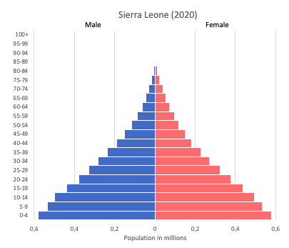
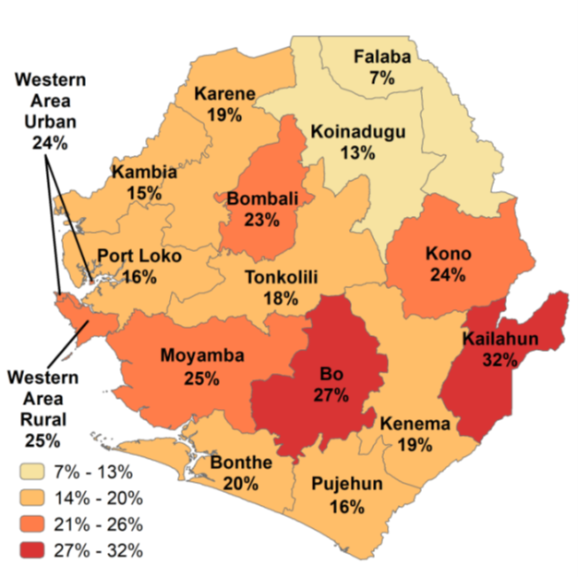
With high rates of child marriage and teenage pregnancy, adolescent SRHR should be the strategic priority
FP 2030 Commitment:
Reduction of teenage pregnancy as a priority
Established a national strategy and secretariat for the reduction of teenage pregnancy and child marriage
.
Only one in five women use a modern method. By 2030, the vision is 90% demand met.
Predominantly Children, Adolescents and Youth
Teenage Pregnancy by District (SLDHS 2019)
21% of pregnancies and 20% of maternal deaths are in the adolescent population
*46.8% of adolescent girls’ deaths in Sierra Leone are due to complications of pregnancy or childbirth
Notes:
What were the reasons for non achievement of 2022 mCPR goals? Less than half of the population who needed FP did not have access to all methods, Varying percentage of stock outs of Inject (41%), Implants 29%, IUDs (175), Pills (17%), Condoms (14%) stock out were
Improved policy and legal environment
Affirmative laws around the age of consent for services
Task sharing, CHWs at the forefront of service provision
Greater investment by the private sector
School Health Policy
Increased access to quality family planning and increase in mCPR
Postpartum family planning (PPFP) uptake is the first high-impact and strategic priority of CIP 2030
Ensure all peripheral health units (PHUs) provide adolescent-friendly and young people-friendly family planning services including outreach services in schools and other learning centers.
CHWs to conduct regular outreach to adolescents, especially to girls who are not in school.
Strengthen partnerships with the private sector (private pharmacies and drug shops) to improve access of family planning services to adolescents (given their convenience of access and less stigma).
Strengthened supply chain, Medicines and medical products represent the largest area of cost for the health sector, largely dependent on external donor support. Led by The National Medical Supplies Agency (NMSA) and National Health Supply Chain Strategy (NHSCS). Improve the incidence of no stock-out to 60%. Institutionalize a last-mile assurance mechanism.
Transformed social and gender norms, greater autonomy and agency to RH info, and services for women & and girls, men, youth, vulnerable populations
Sustainable financing for family planning. Inclusion of family planning services under the Sierra Leone Social Health Insurance (SLeSHI) package
In Sierra Leone, UNFPA provides over 90% of national contraceptive requirements. In 2022, UNFPA supported the procurement of US$ 3.5 million worth commodities for the country, helping to avert 210,000 unintended pregnancies, 76,000 unsafe abortions and 1,700 maternal deaths. United Nations Population Fund (UNFPA) procured modern reproductive health commodities with a value of US$ 576,000 to help end unmet need for family planning in Sierra Leone between January and March 2023.
Almost 60 per cent of young people in Sierra Leone are unemployed, driving their urge to seek work abroad, usually via irregular migration.
Yet in an economy still struggling after the ravages of a decade-long civil war, there’s also strong, unmet demand for skilled labour—including repairing and operating farming, road construction and mining machinery.

Slide 6
02. Core Market Function: Demand FP Use/Need Analysis

Slide 7
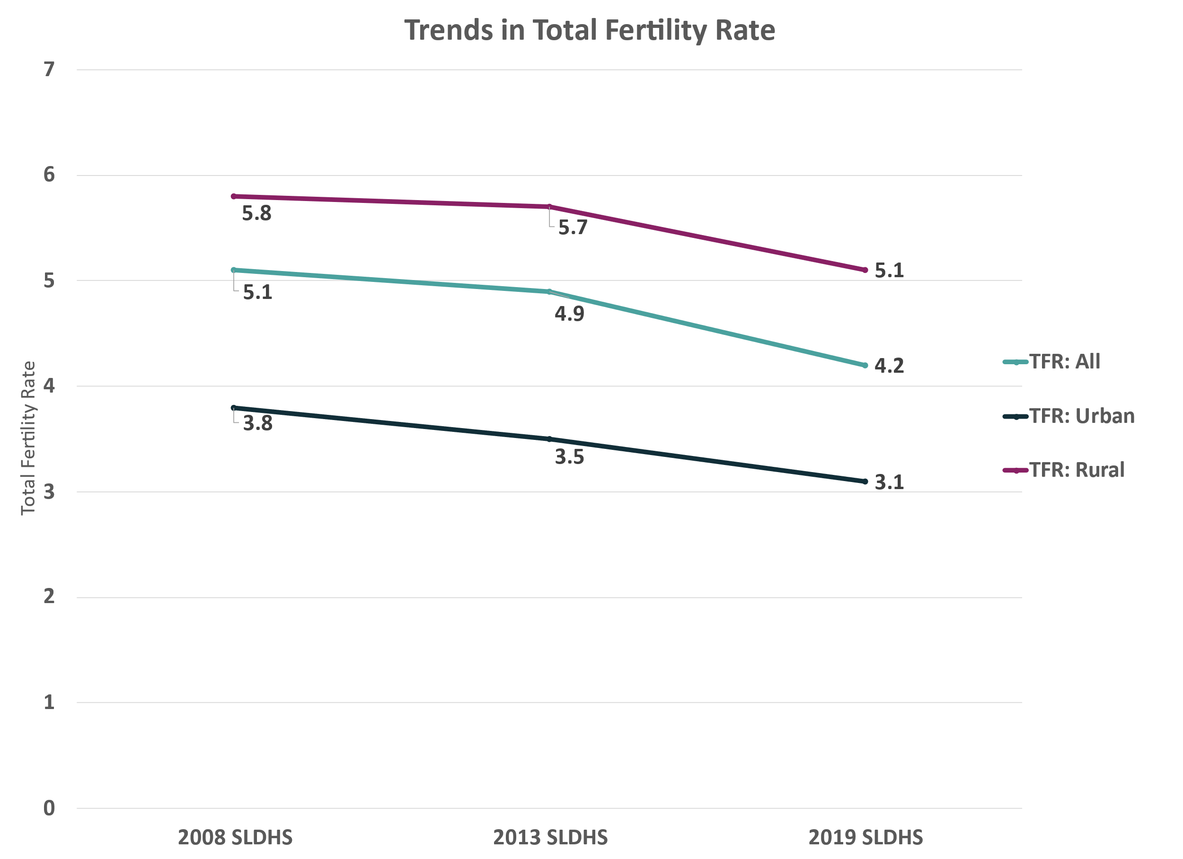
The total fertility rate (TFR) has been declining over time and remains highest in rural areas
Sources: SLDHS 2008, SLDHS 2023, SLDHS 2019

Slide 8
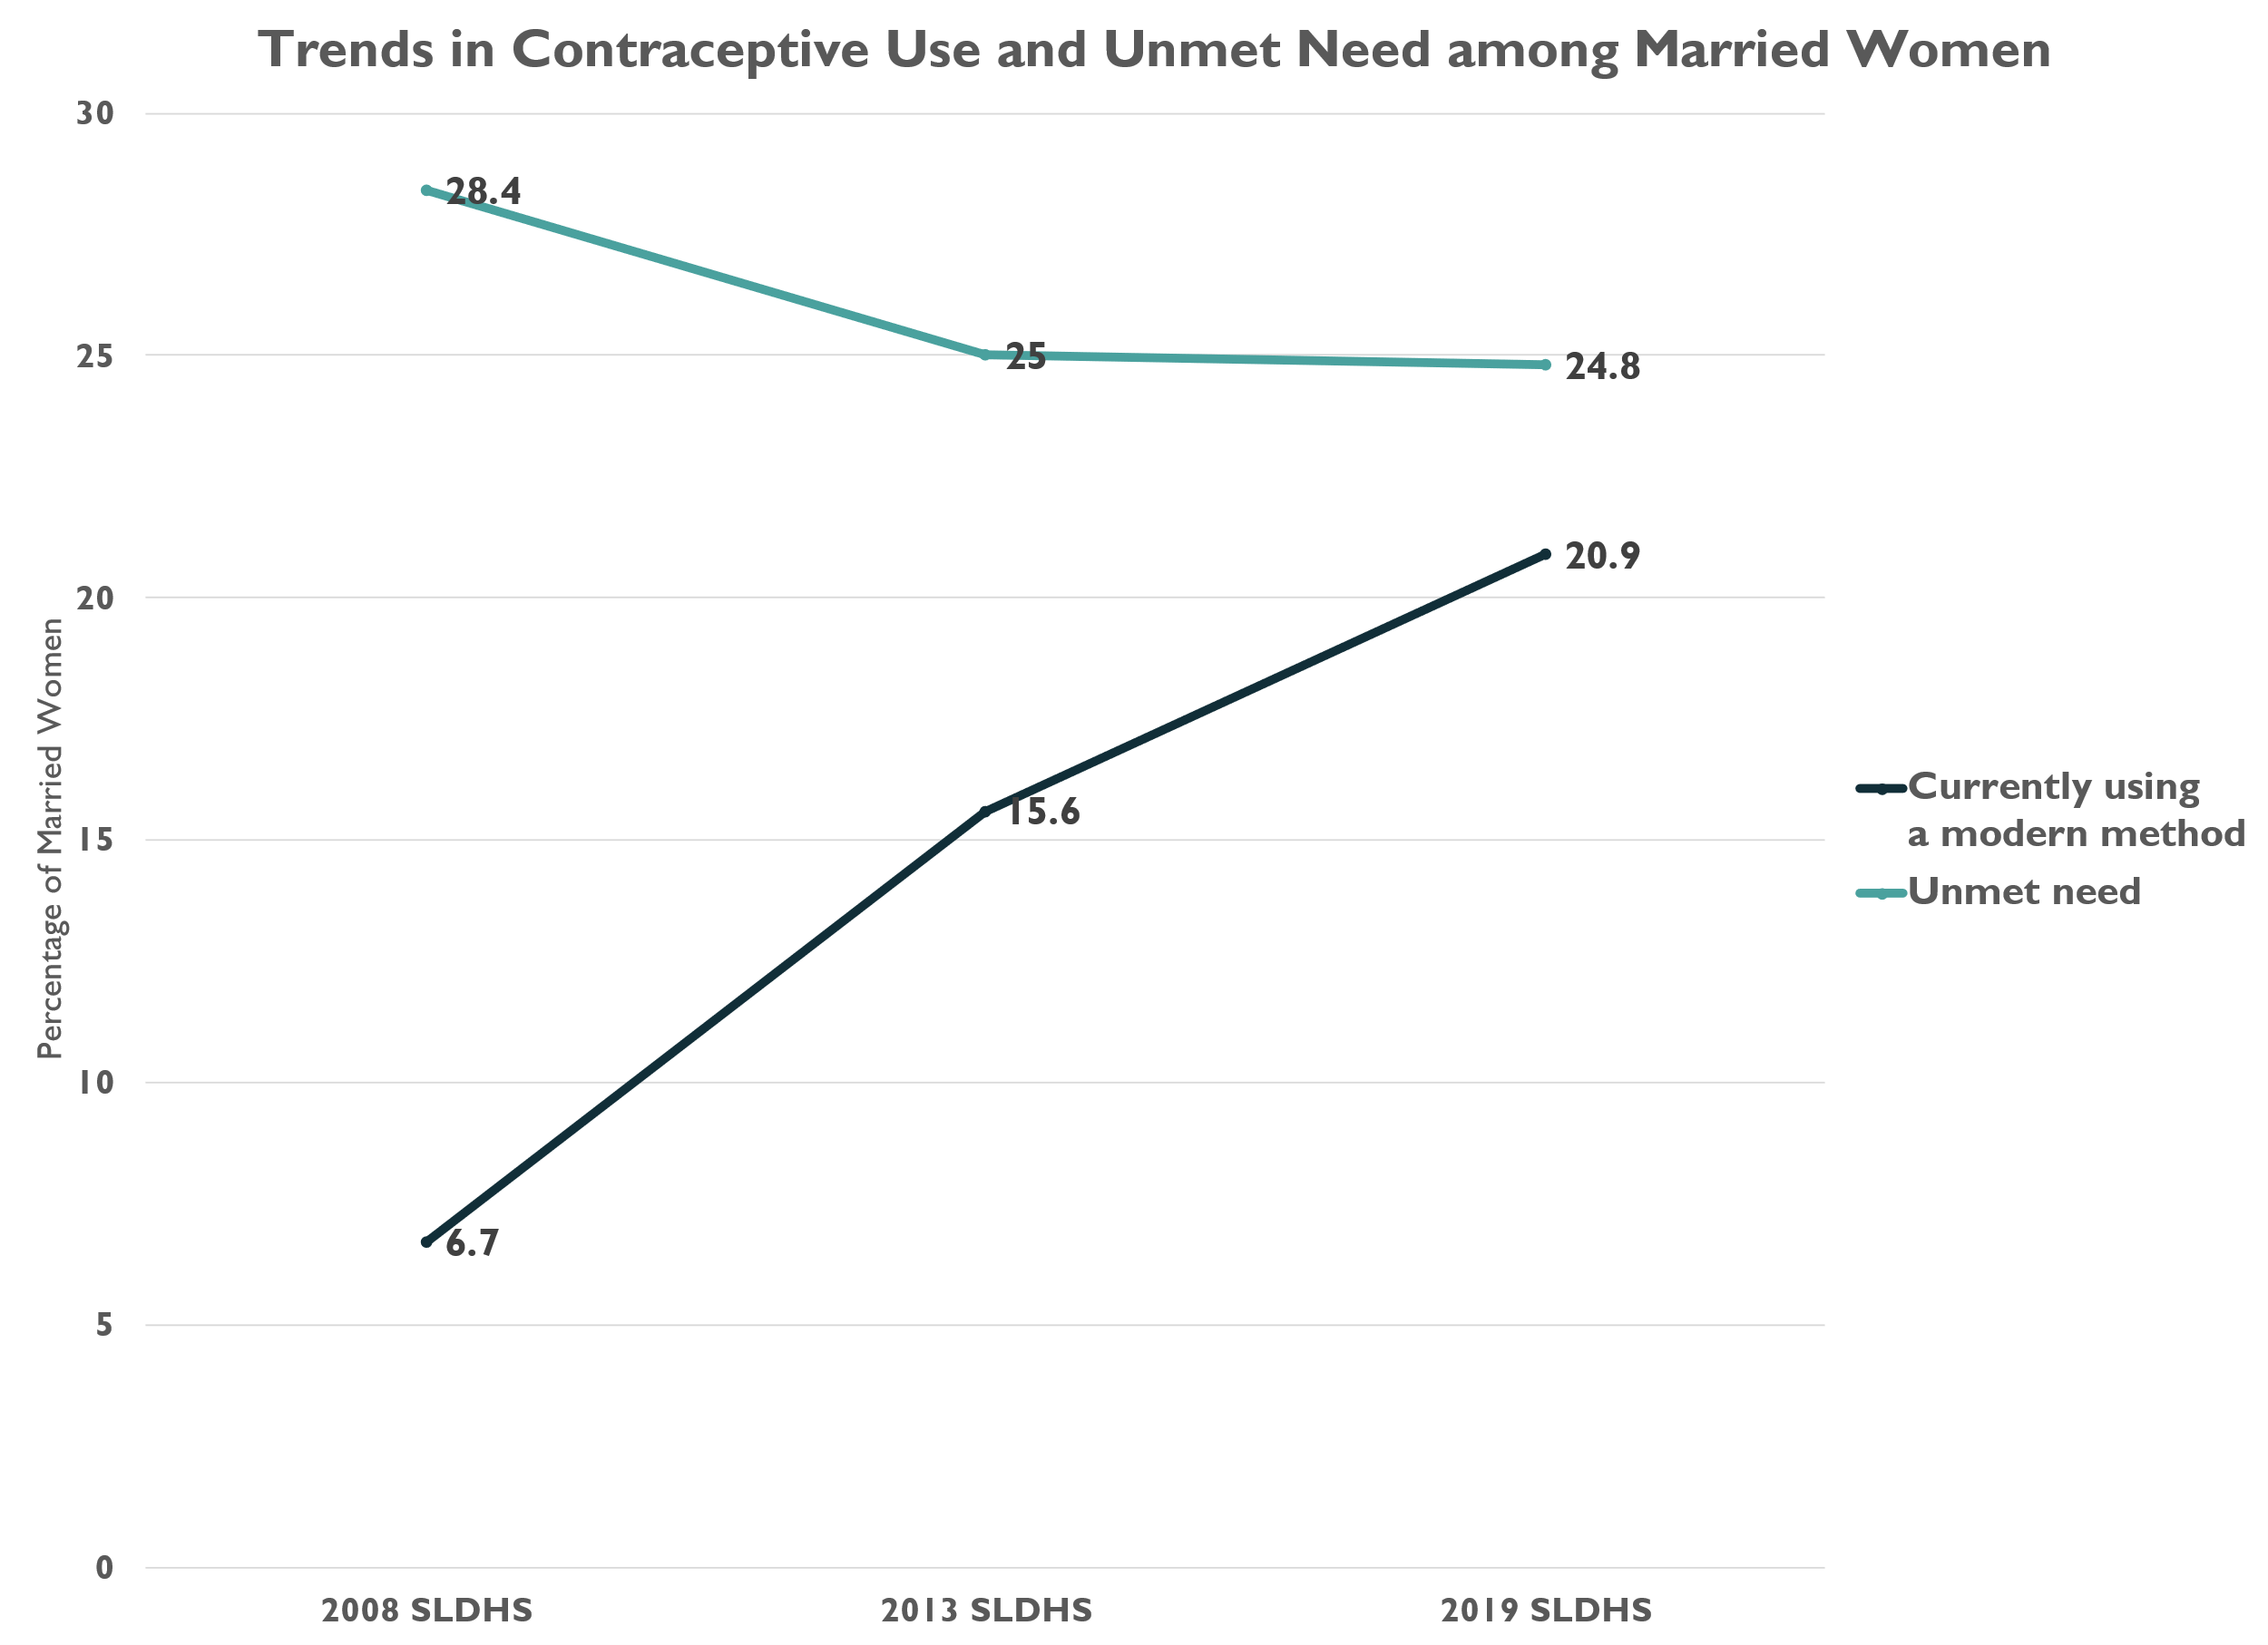
While the mCPR among married women has risen dramatically, still fewer than 1 in 5 women are using a modern method while reductions in unmet need have stagnated
Sources: SLDHS 2008, SLDHS 2013, SLDHS 2019

Slide 9
The contraceptive use/need gap is an estimated 472,000 women ages 15-49 in Sierra Leone
Does not want to be pregnant
678,749
Uses a modern method
308,424
Need = 935,462
Married
1,478,980
Wants to be pregnant
Uses a traditional method
4,548
Use = 463,761
Pregnant, lactating, or sterile
Does not use contraception
365,778
Women of reproductive age (WRA)
2,361,301
Use/Need gap =
471,702 women
Does not want to be pregnant
256,713
Uses a modern method
155,337
Sexually active
293,851
Unmarried
888,321
Wants to be pregnant
Uses a traditional method
1,823
Not sexually active
Women 15 to 49 years old –
Contraceptive need and use
Sources: PHC 2015 and SLDHS 2019
(2015 Census population estimate projected to 2023 at 3.2% annual growth rate)
Pregnant, lactating, or sterile
Does not use contraception
99,553
Notes:
For the modern method, can the traditional method users be added as an unmet need for modern methods for conversion, albeit a small number?

Slide 10
Adolescents (15-24) account for nearly a third of the overall use/need gap
Supporting unmarried adolescents 15-19, and as they get older and get married,
can help to close the use/need gap
Need = 935,462
Use = 463,761
Married 15-19
Use/Need gap = 20,215
Unmarried 15-19
Use/Need gap = 39,018
Married 20-24
Use/Need gap = 57,670
Unmarried 20-24
Use/Need gap = 27,075
All Women WRA
Use/Need gap = 471,702
Source: SLDHS 2019
*Note: Unmarried = unmarried and sexually active in past 4 weeks

Slide 11
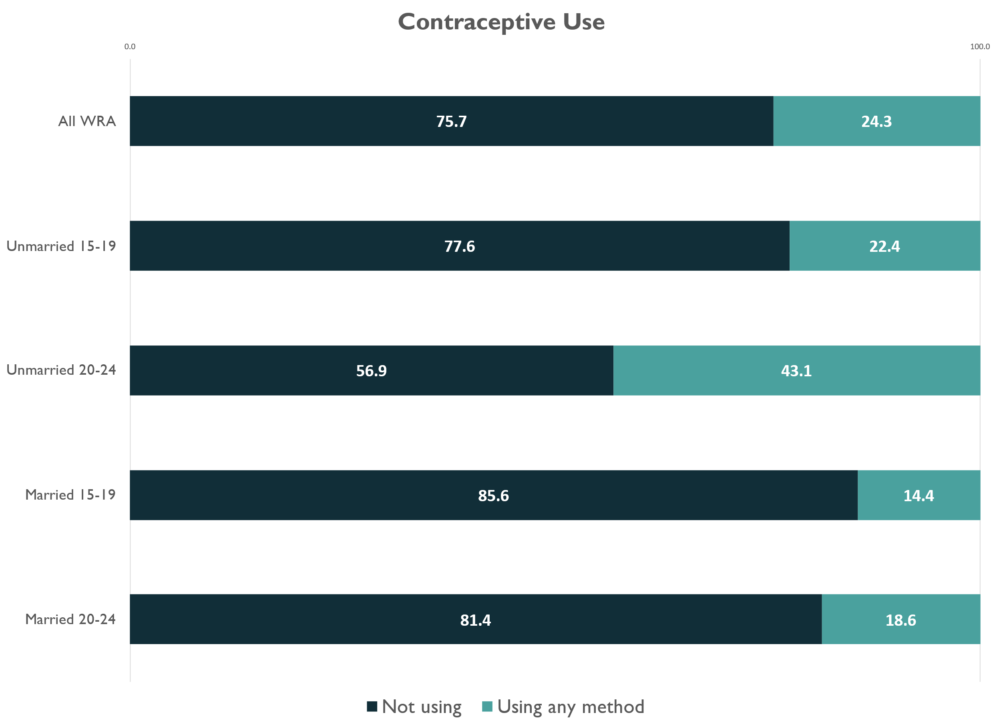
Among young women (ages 15-24), use is lowest among those who are married
Contraceptive use is highest for unmarried women ages 20-24
Contraceptive use is lowest for married women ages 15-19
Source: SLDHS 2019
Notes:
Is 20-24 considered adolescents or later adulthood?

Slide 12
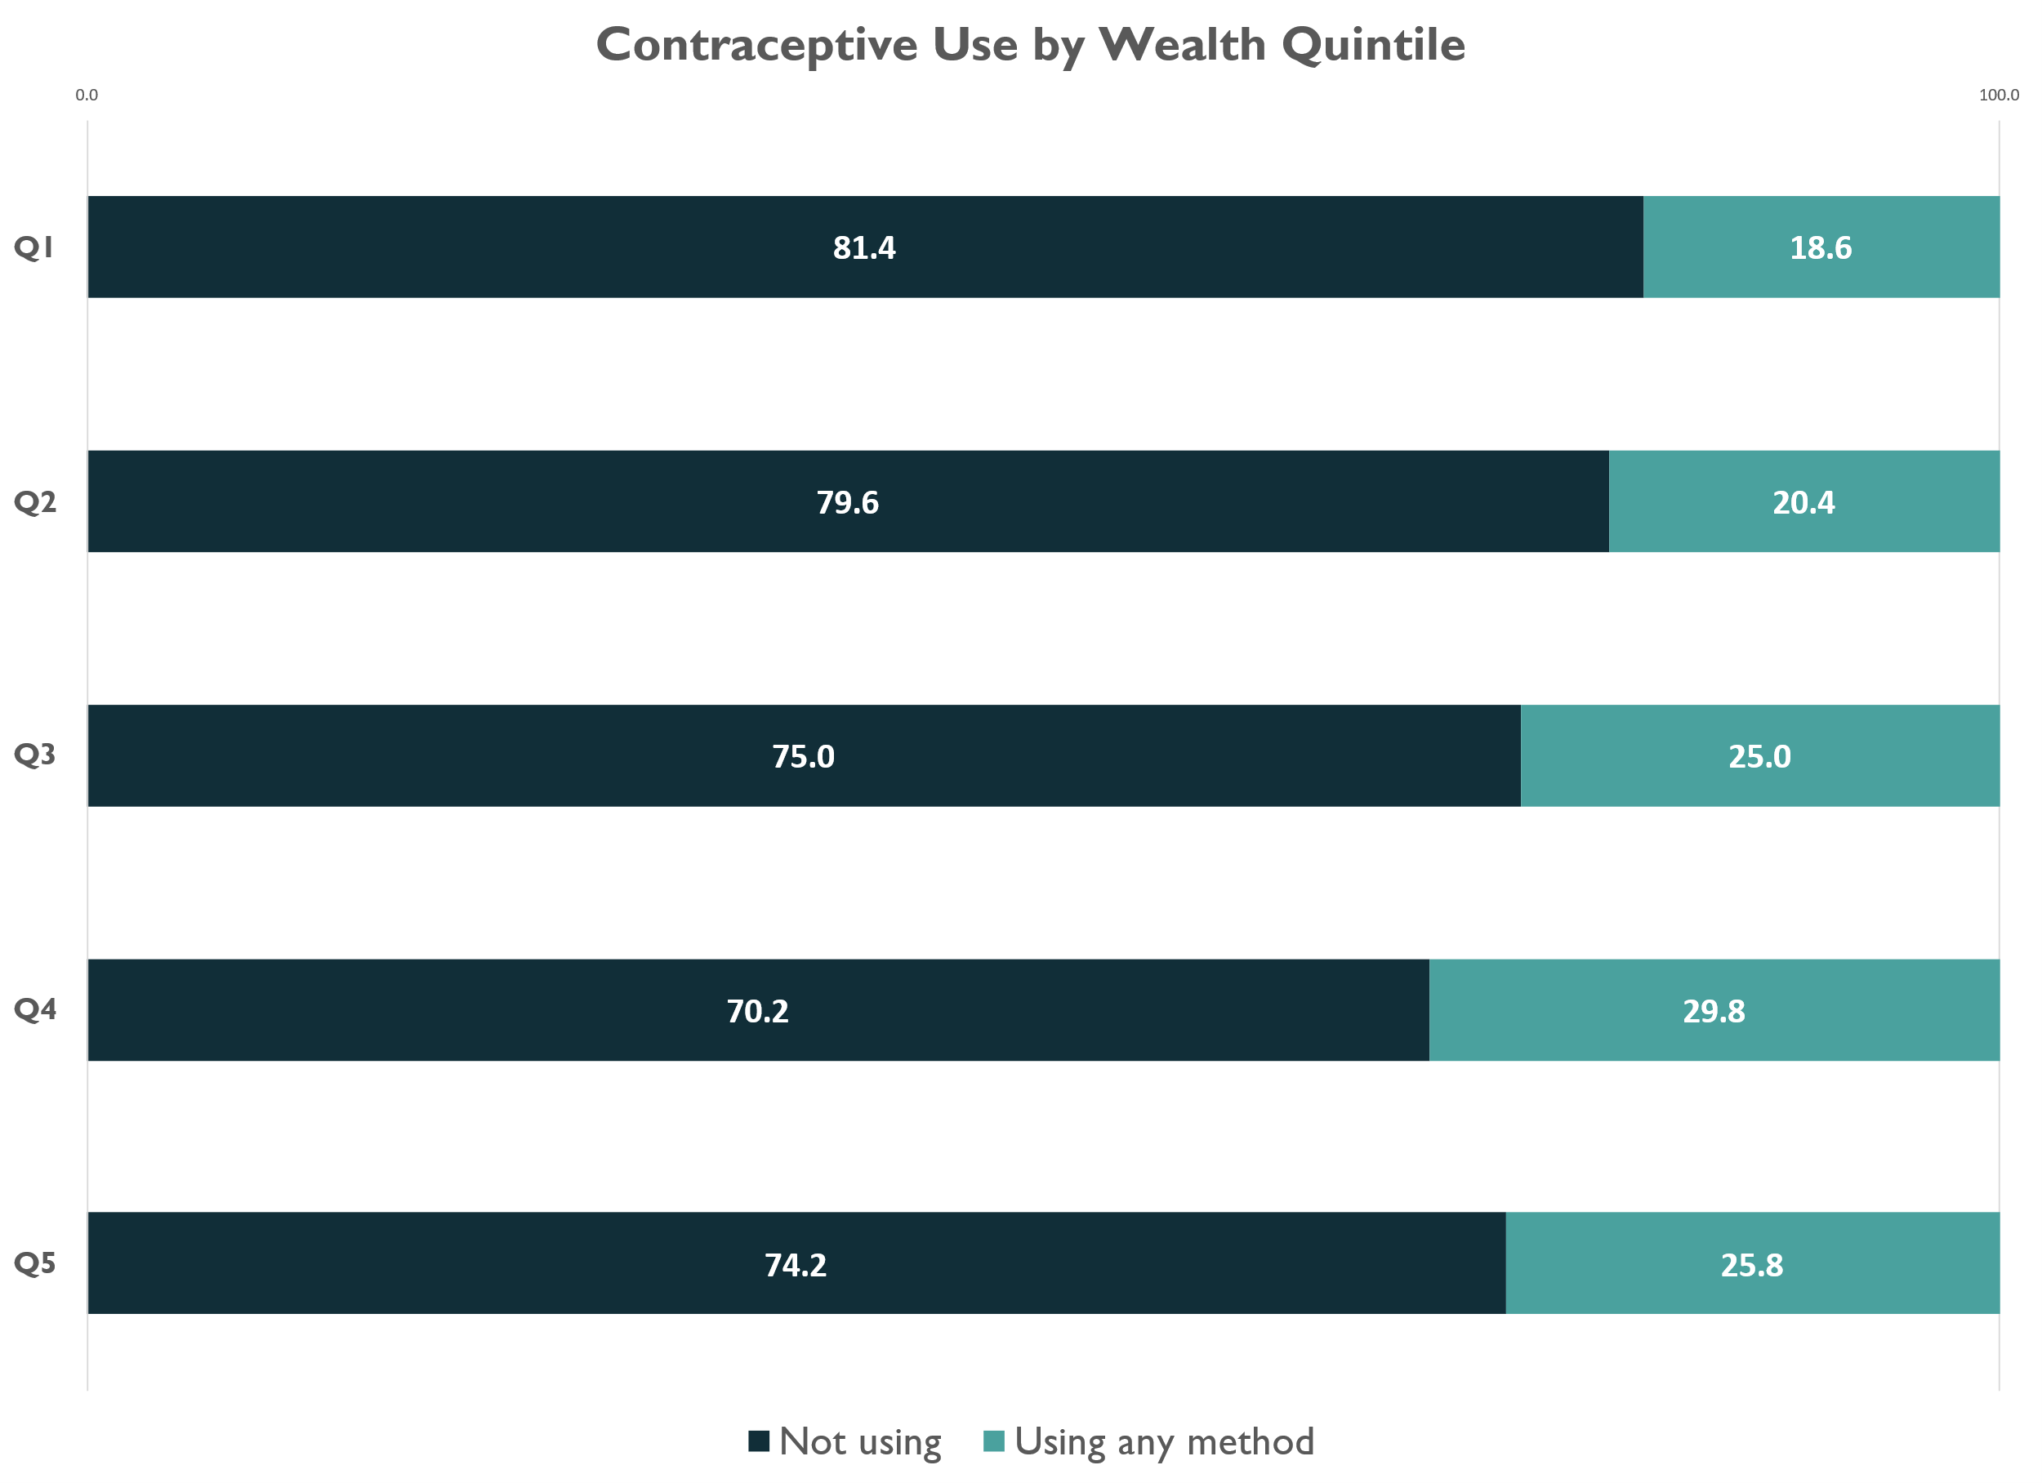
The poorest wealth quintiles have the lowest levels of contraceptive use
Source: SLDHS 2019

Slide 13
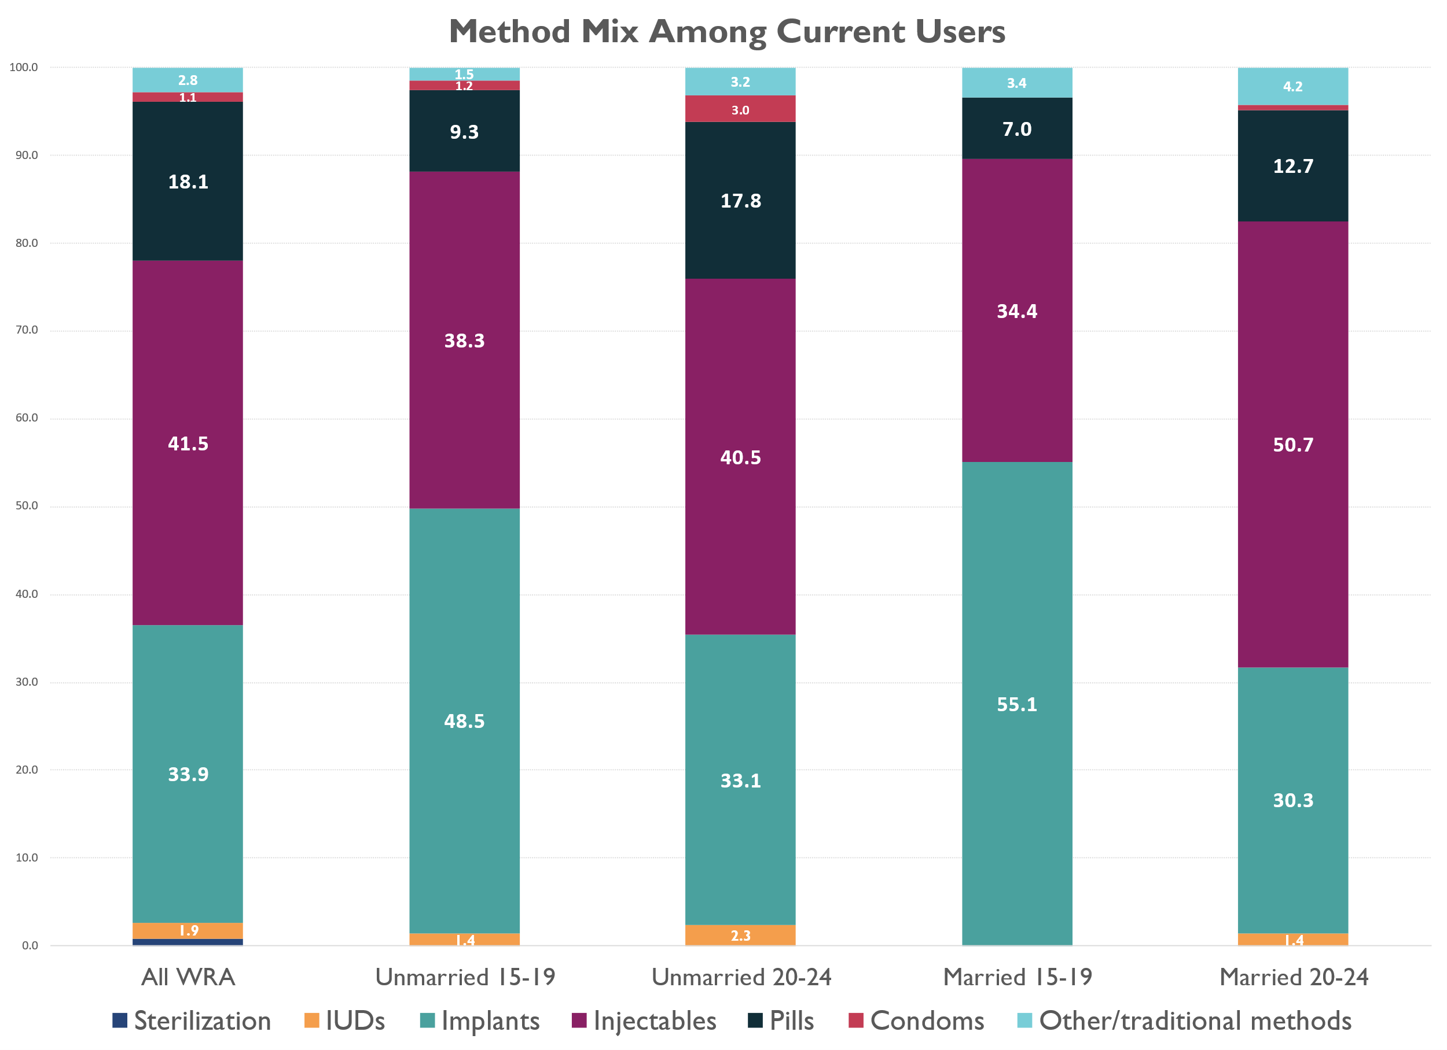
Among current users, injectables and implants are the most popular methods
Young women ages 15-24 are using implants, but this shifts as they get older and begin to choose injectables and pills more frequently
Very few women in this age group are using IUDs or have chosen sterilization
Source: SLDHS 2019
Notes:
Youth is 15-24 year olds ( also termed as younger people)
Reference: https://www.usaid.gov/policy/youth

Slide 14
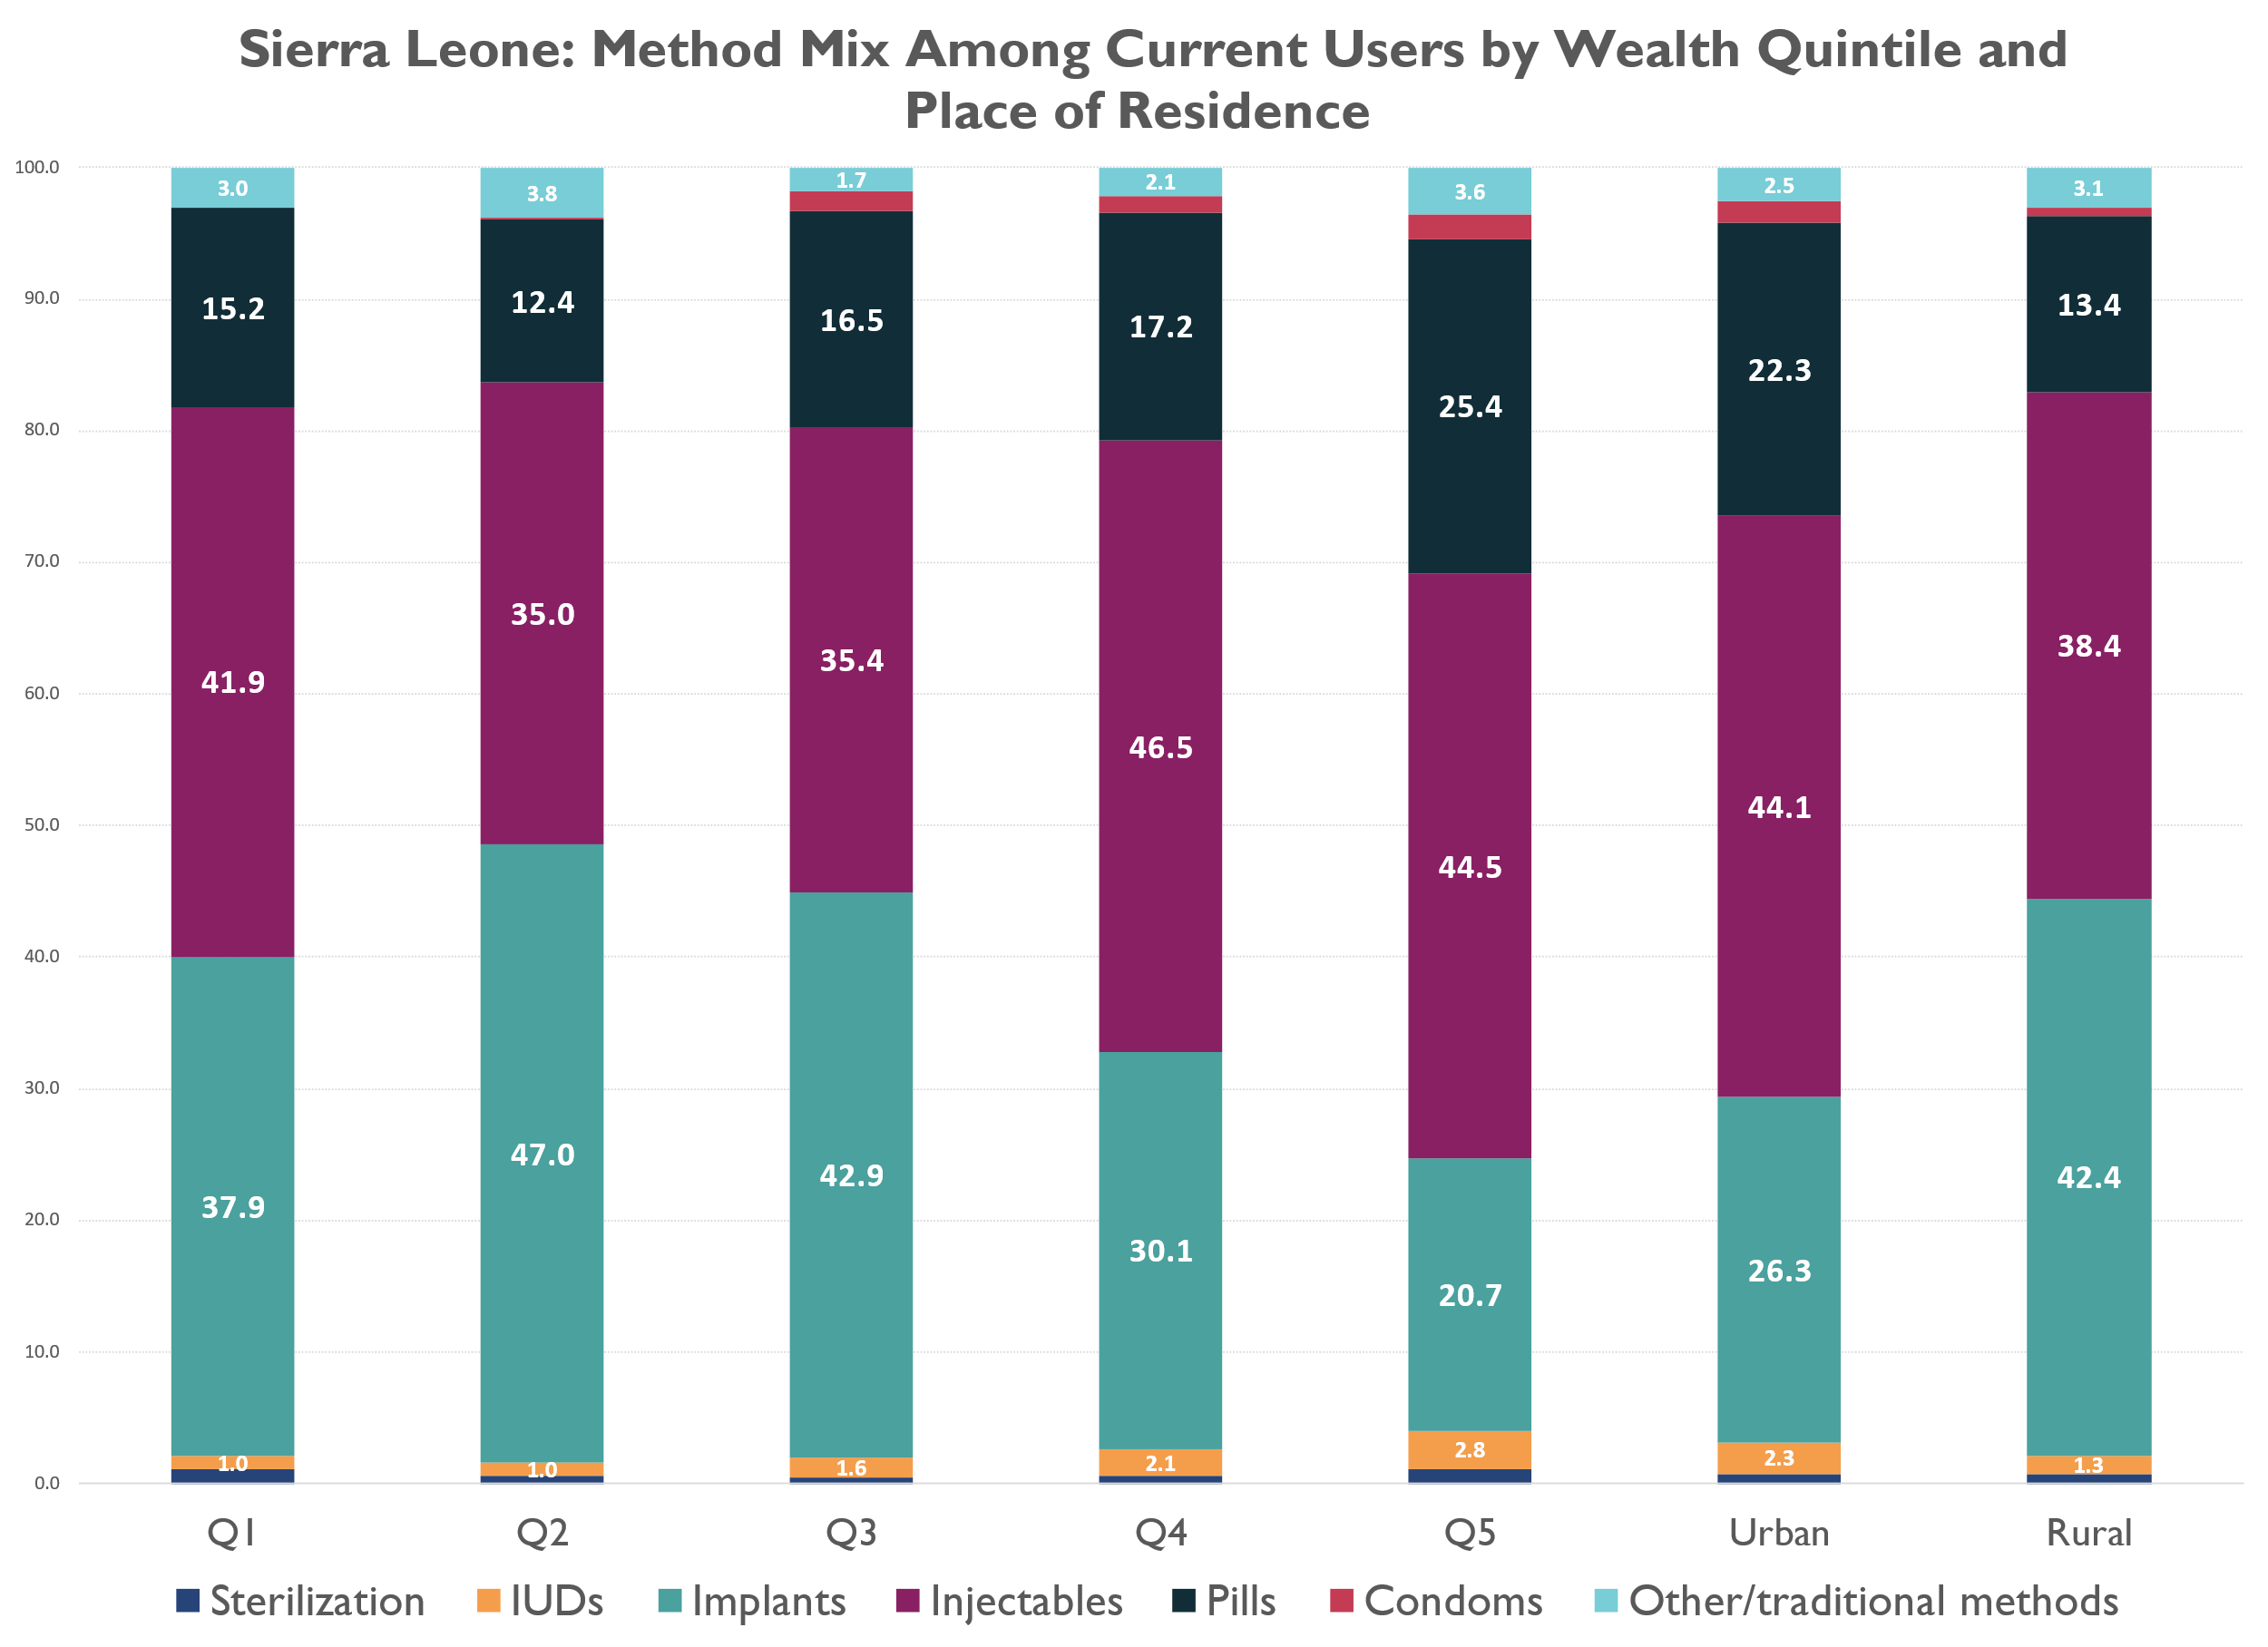
Implants are a preferred method among the lower wealth quintiles and women in rural areas
Injectables and pills are more popular among the higher wealth quintiles and women in urban areas
Source: SLDHS 2019

Slide 15
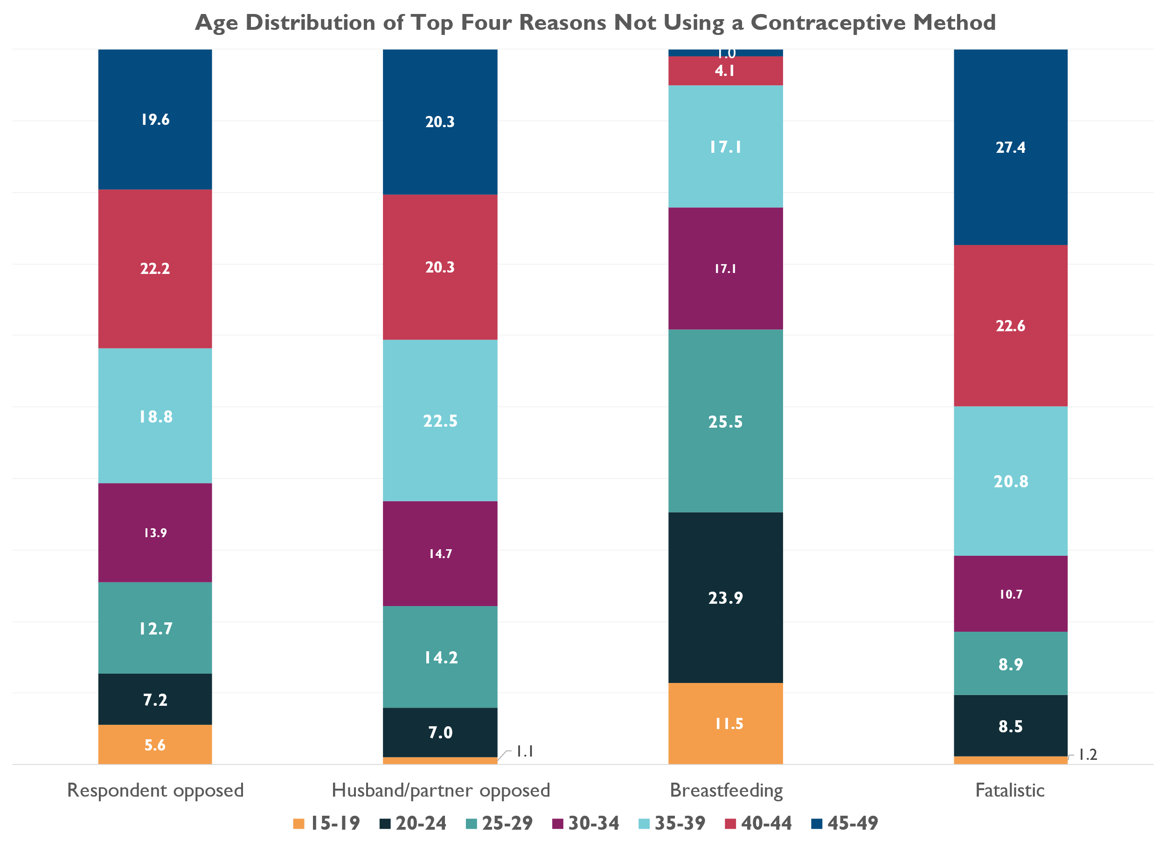
Women in Sierra Leone report three main reasons for not using contraception: Opposition to use, that they are breastfeeding, and a sense of fatalism
Younger women tend to cite breastfeeding as the reason they are not using contraception
Opposition to contraceptive use (her own or her husband’s) is greatest among older women
Source: SLDHS 2019
*Age distribution is among women who cite the reason
“Fatalistic” are response options that capture the notion that pregnancy is up to God’s will or if it happens, it happens

Slide 16
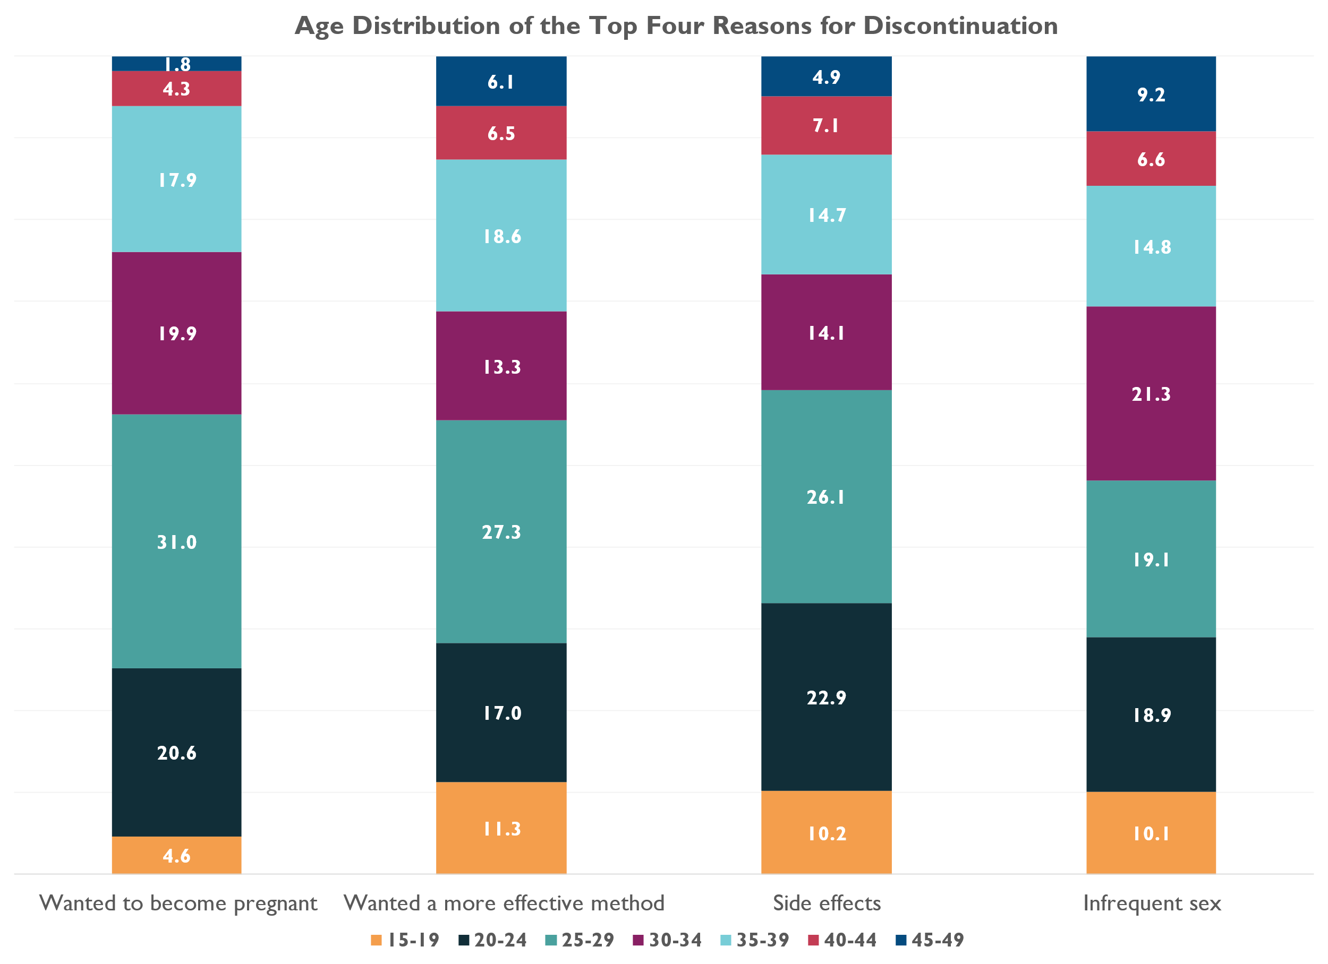
Women in Sierra Leone most often discontinue a method because they want to become pregnant, due to side effects or wanting a more effective method, or because they are having infrequent sex
Younger women cite side effects frequently as the main reason
And as they get older, they either want to become pregnant or want a more effective method
Source: SLDHS 2019
*age distribution is among women who cite the reason

Slide 17
Summary | Use/Need analysis
The market is currently underserving:
Adolescent girls and young women
Unmarried women
Women in lower wealth quintiles
Other opportunities:
Not using a modern method: There is a need to better understand behaviors around lactational amenorrhea, improve norms and acceptance around opposition from partners
Discontinuation: There is a need to address support and management of side effects, increase knowledge and expectations around methods at different stages of life
Photo Credit: YoMSuD Sierra Leone Uninterrupted project

Slide 18
03. Core Market Function: Supply Market Breadth & Depth

Slide 19
Sierra Leone has an overall low density of health workforce, and around half of them are in the capital city (Freetown)
Health Infrastructure
While 57% of population is rural based, only 2% of doctors,29% of nurses & midwives are rural based.​
40% of all midwives are based in the capital Freetown.​
FP commodities for private sector are all imported, and key channels for access are pharmacies and patent stores ( drug stores which sell over the counter methods like condoms & OCPs).​
Est 30 % *
Private Health Facilities Offer Family Planning
PUBLIC**
PRIVATE**
Hospitals
1,288
81
Health Centers
1,280
-
Qualified Doctors
7,107
335
Pharmacies
176
1,381
Pharma Importers
-
94
0
1,040
Patent Stores
289
165
Pharmacists/Technologists
* Source: Global Financing Facility & RHSC: Maintaining Access to Contraceptives During COVID-19 Disruptions
https://www.globalfinancingfacility.org/sites/gff_new/files/images/COVID-19_FP_1_pager_Sierra-Leone.pdf
**Source: World Bank statistics, World Bank 2020 Private Sector Health Assessment, Human Resources for Health Strategy 2017-2021,Human Capital Index
Notes:
There's a low density of these entities, which presents a potential business opportunity.
Low density of Private sector Importers, Doctors, Pharmacies, and Patent Stores: This indicates that there are not many businesses or professionals in the Pvt health sector (importers, doctors, pharmacies, patent stores) in a given area. A low density may imply possibly unmet demand in the market.
Opportunity to shape practices for serving relevant consumer segments in current catchment areas: This points towards the chance to influence how business is conducted to better serve the needs of the population within the region where these businesses operate. "Shaping practices" might involve setting new standards, offering better services, or creating more tailored solutions for consumers.
Providing incentives for expanding coverage: This part suggests that there is room for growth. By providing incentives, which could be financial, marketing support, or other business development tools, existing businesses can be encouraged to increase their service areas. Expanding coverage could mean opening new locations, extending service hours, offering delivery services, or any number of strategies to reach more consumers.
Overall, the strategy maybe capitalizing on a market with low competition by setting standards and practices that appeal to the local consumer base, and encouraging growth to saturate the market effectively before competitors enter. This kind of approach is common in strategic business development, especially in sectors where demand is high, but supply is not fully developed.
World Bank reference : https://openknowledge.worldbank.org/entities/publication/e86c0905-552e-4319-b8ff-990fec474fcf

Slide 20
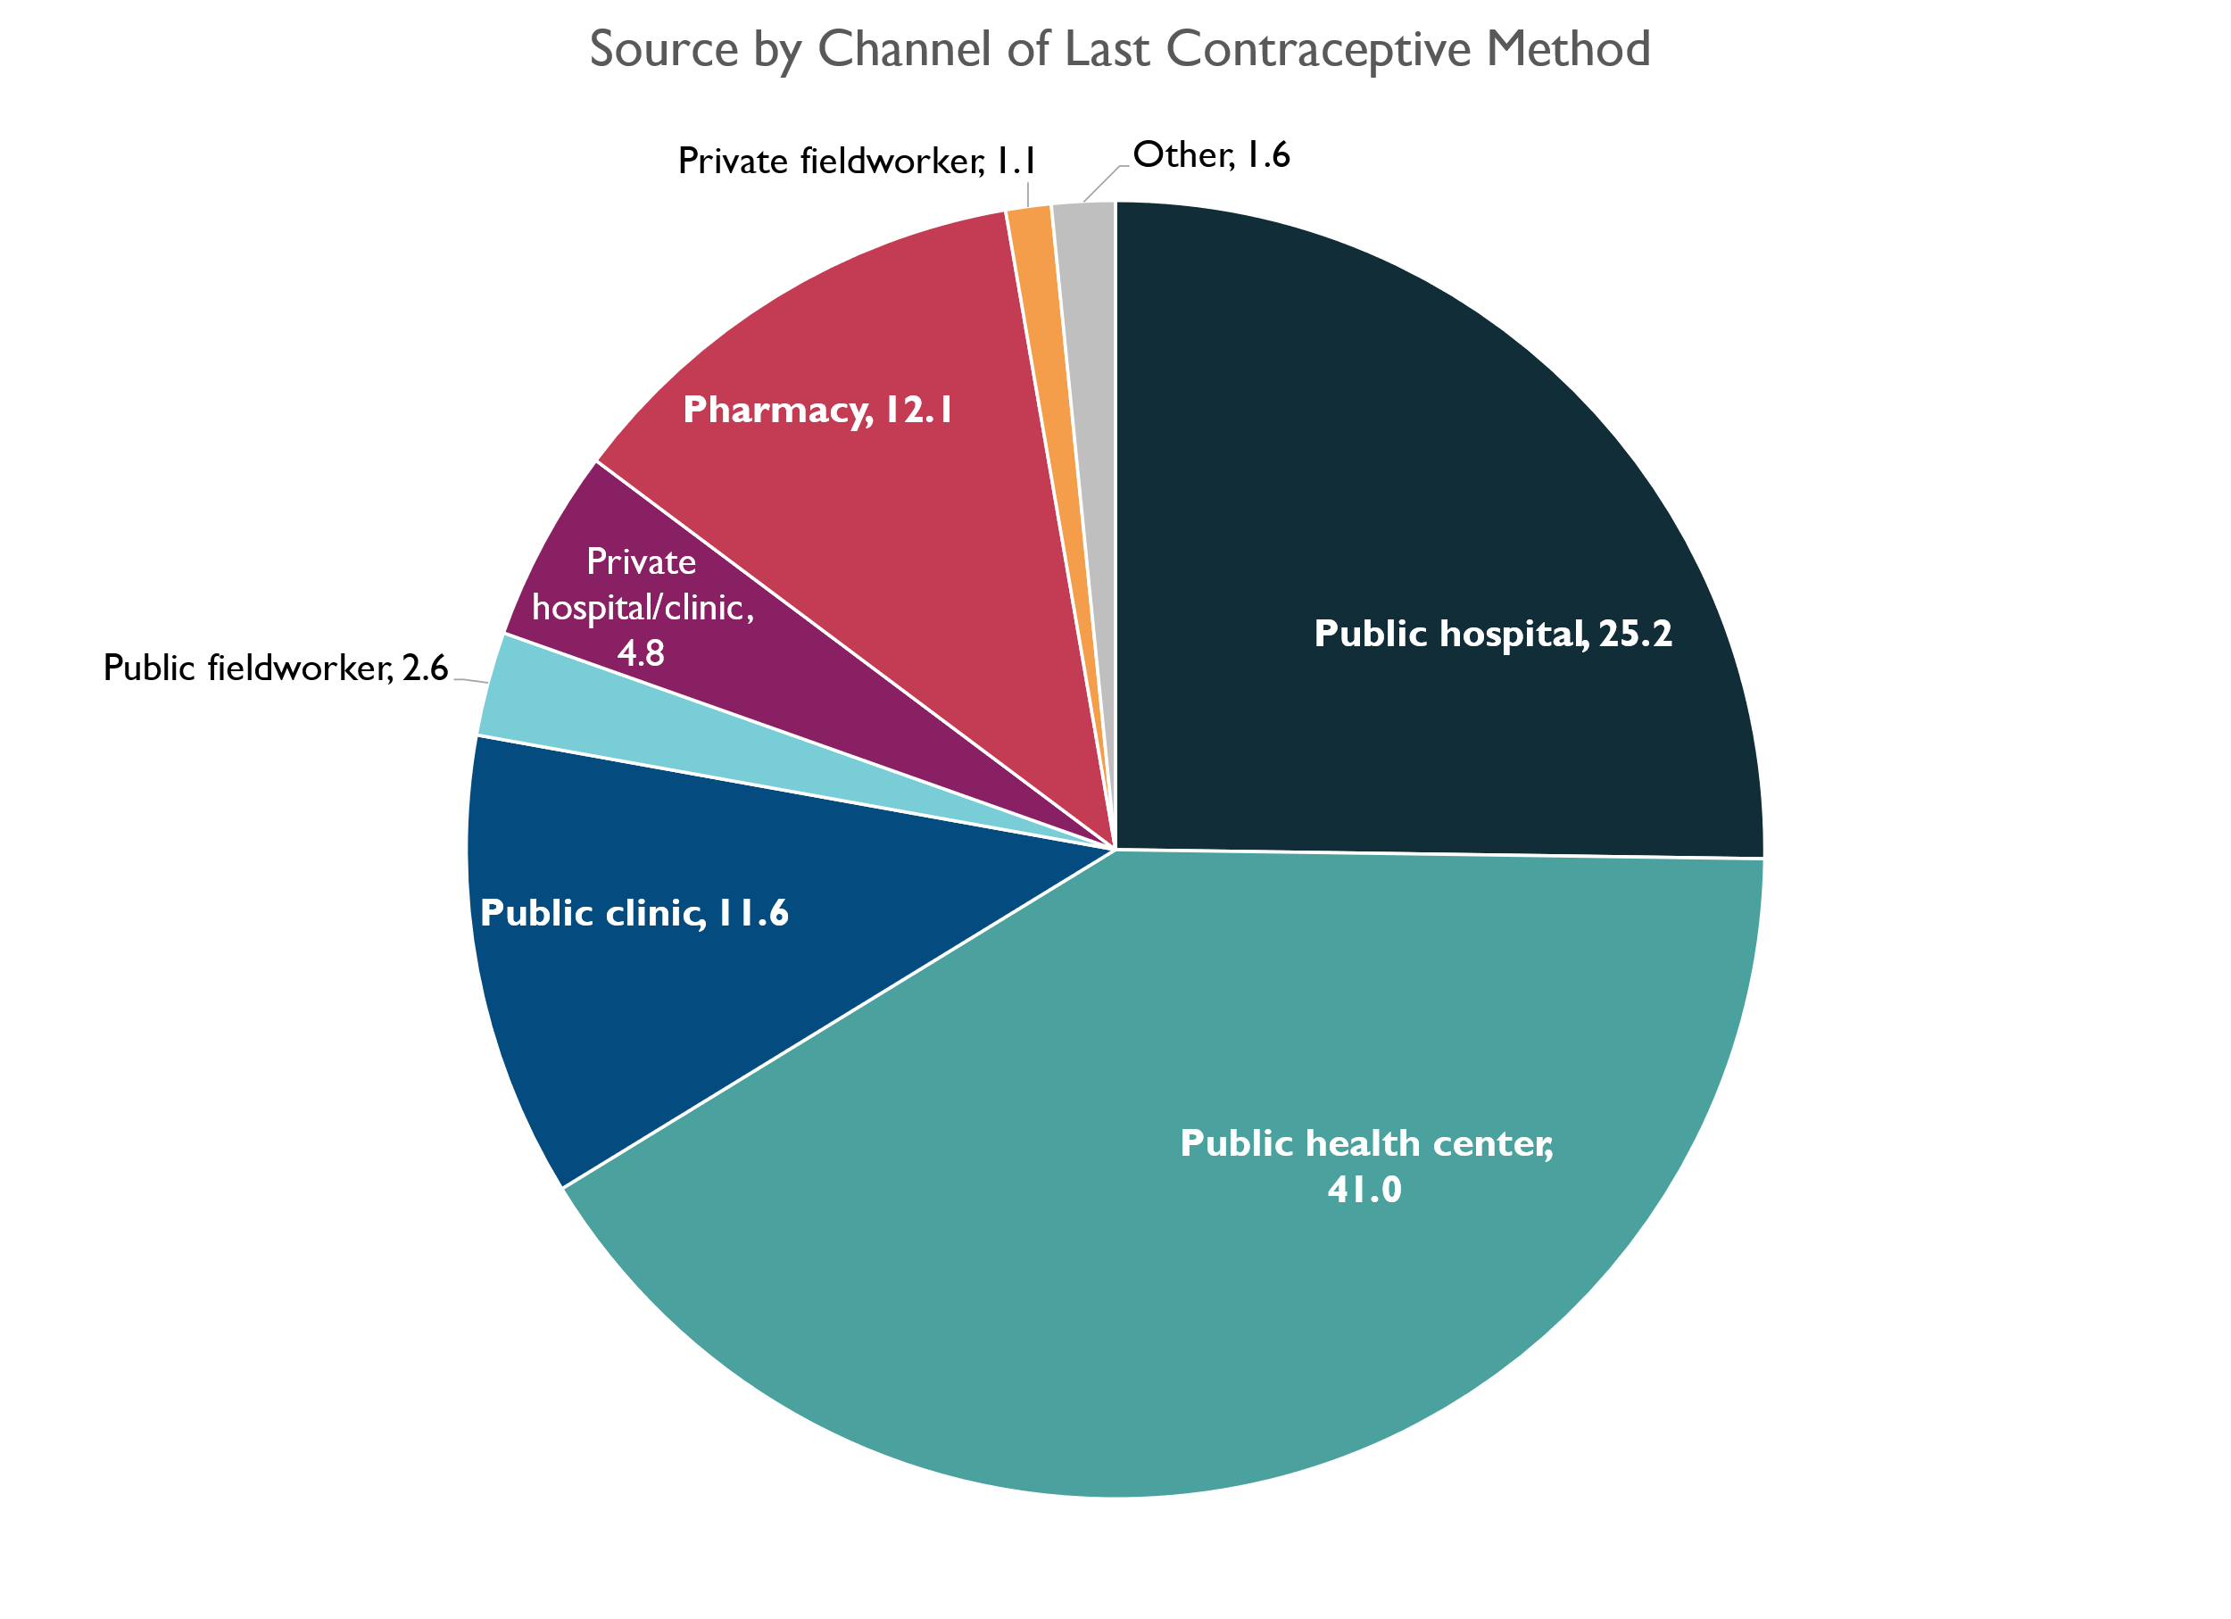
Most contraceptive users in the public sector go to hospitals or health centers while in the private sector, they most often go to pharmacies
Reaching FP users via the pharmacy channel appears promising
It is important to understand the interactions among private sector nodes (private sector clinics, pharmacies and private fieldworkers)
Source: SLDHS 2019
Notes:
Public vs. Private Sector Usage: The majority of people get their contraceptives from the public sector. Hospitals and health centers are the main providers, with public hospitals accounting for 25.2% and public health centers for 41.0%. The private sector is used less frequently, with private hospitals/clinics at 4.8% and pharmacies at 12.1%.
Potential of Pharmacies: Pharmacies seem to be a promising point for reaching people who need family planning (FP) services, indicating that they could play a larger role in the distribution of contraceptives.
Importance of Collaboration in the Private Sector: Understanding how private clinics, pharmacies, and fieldworkers collaborate and interact is important. These connections could help improve the availability and efficiency of family planning services within the private sector.
In summary, while most contraceptive users rely on the public sector, there is significant potential for pharmacies in the private sector to meet family planning needs. Enhancing cooperation between private sector entities could further strengthen their role in this area.

Slide 21
Market Breadth by Sector
Modern methods availability
by sector
Public Sector
Offers 10 Choices (OCP: POP + COC, DMPA, Implants, IUD, Male Condoms, Female Condoms, EC Pills, Vasectomy, Tubal ligation)
Social Marketing ( DKT)
Offers 7 Choices ( COC, DMPA, Implants, IUD, Male Condoms, Female Condoms, EC Pills)
NGO Sector (MSI,IPPF)
Offers 10 Choices ( OCP: POP + COC, DMPA, Implants, IUD, Male Condoms, Female Condoms, EC Pills, Vasectomy, Tubal Ligation
Commercial Sector
Offers 8 Choices (OCP: POP + COC, DMPA, implants, IUD, Male Condoms, Female Condoms, EC Pills)
OCP: Oral Contraceptive Pills
POP: Progestin only pills
COC: Combined Oral Pills
EC: Emergency Contraceptives
Source: 2021 USAID GHSCP CS indicators

Slide 22
Sierra Leone FP modern methods market breadth: Few brands offered in the private sector dominated by SMOs
Family Planning*
Short-acting reversible method
Long-acting reversible method
Long-acting permanent method
Post-coital
method
Condoms
IC
LARC
Sterilization
ECP
MA
OCP
Plain
Premium
Daily
Weekly
DMPA
Implant
LNG-IUD
Female
1-pill
Combi
Miso
Surgical
6 brands
2 brands
4 brand
0 brands
3 Mn.
1 Brand
1Brand
4 Brands
5 brands
2 brands
* Estimated from DKT SMO Sales stats, Distributor Interview and Volzh Import Data Dec 2023 .
Notes:
IM DMPA, DMPA SC, and IM Norethisterone Enanthate

Slide 23
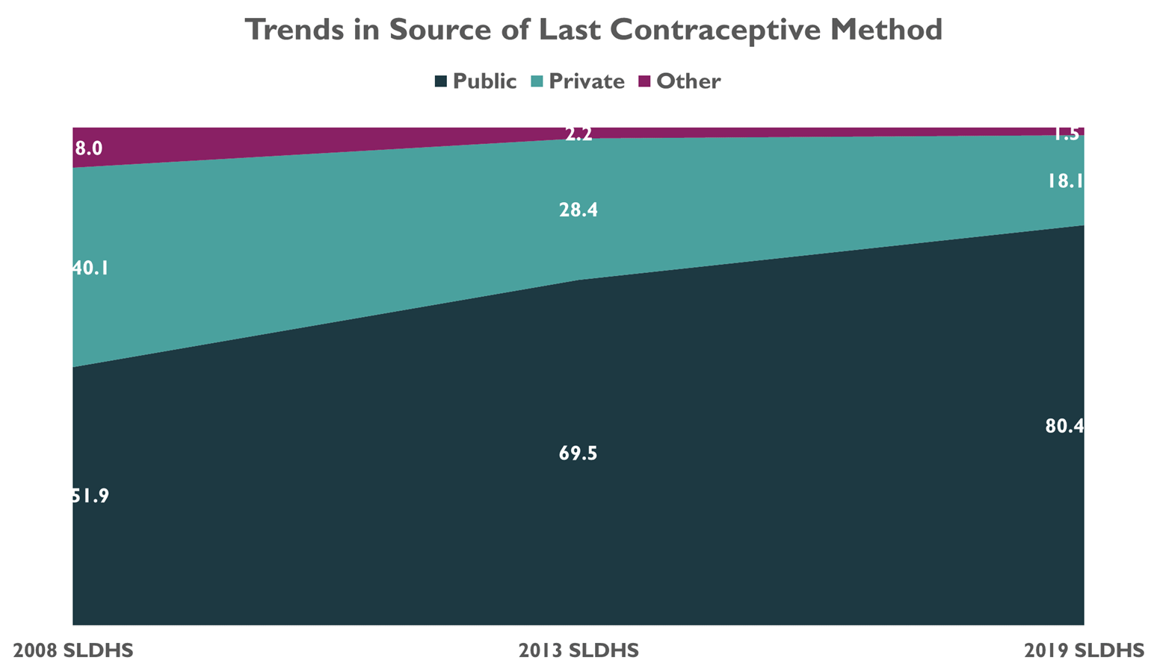
DHS analysis reveals declining use of the private sector over time for obtaining modern contraceptive methods
We need to understand more clearly what drives this declining use of the private sector
Sources: SLDHS 2008, SLDHS 2023, SLDHS 2019
Notes:
The decline in the use of the private sector for contraceptive methods, as indicated in the DHS analysis, could be due to several factors:
Public Sector Improvements: If the public sector has improved its services, offering a wider range of contraceptive options, better quality of care, and more accessibility, it could draw users away from the private sector.
Financial Considerations: Contraceptives provided by the public sector may be free or subsidized, making them more affordable than those offered by the private sector, especially in low-income areas.
Post-Ebola Health Infrastructure Changes: Following the Ebola crisis, there may have been a significant investment in public health infrastructure, leading to a more robust public health system that people rely on more than the private sector.
Distribution and Accessibility: The public sector might have a more extensive distribution network, especially in rural or underserved areas, where private sector services are less available.
Trust and Reliability: The crisis and subsequent recovery efforts may have bolstered the public's trust in the government's health services, including the provision of contraceptives.
Regulatory Changes: There could have been regulatory or policy changes that have made it more difficult for the private sector to operate or compete effectively.
Economic Factors: Economic downturns can reduce the ability of consumers to pay for private services, leading them to rely more on public services.
Cultural and Social Shifts: Changes in social norms and cultural attitudes towards contraception might lead to increased acceptance of public provision of these services.
Supply Chain Issues: The private sector might have faced supply chain challenges, particularly post-Ebola, which could have affected their ability to provide a reliable supply of contraceptive methods.
Understanding the specific reasons for this decline would require a more in-depth analysis of the health system dynamics, consumer behavior, and economic conditions of the country or region in question.

Slide 24
But sales trends indicate that SMO/private sector is doing well for short-acting modern methods
* Estimates from DKT SMO CSM Sales statistics and Volzh Import Data Dec 2023 .

Slide 25
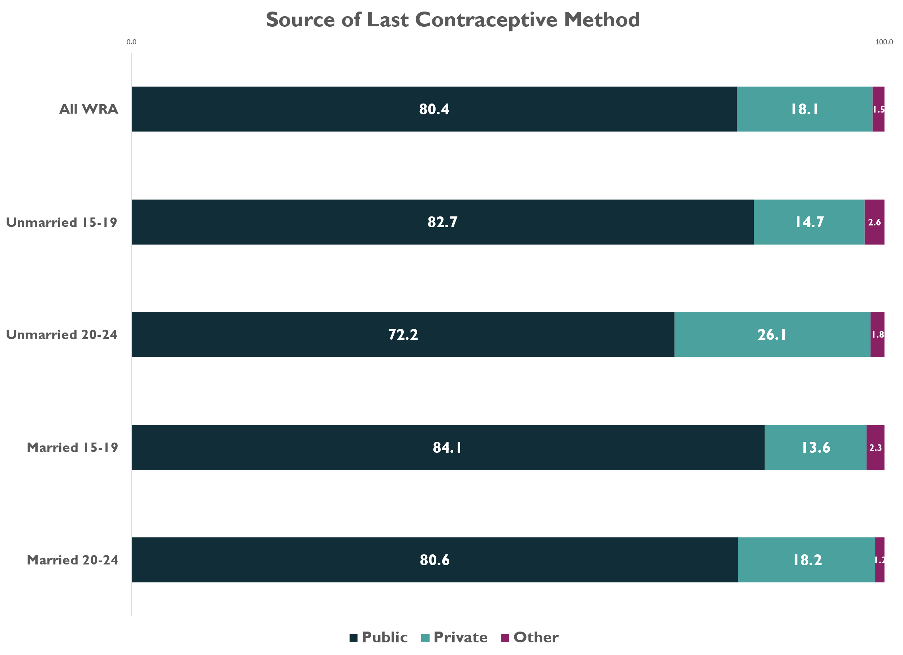
Women ages 20-24 access the private sector for contraceptive methods most frequently
Overall, fewer than 1 in 5 women in Sierra Leone obtained their last contraceptive method from the private sector
Source: SLDHS 2019

Slide 26
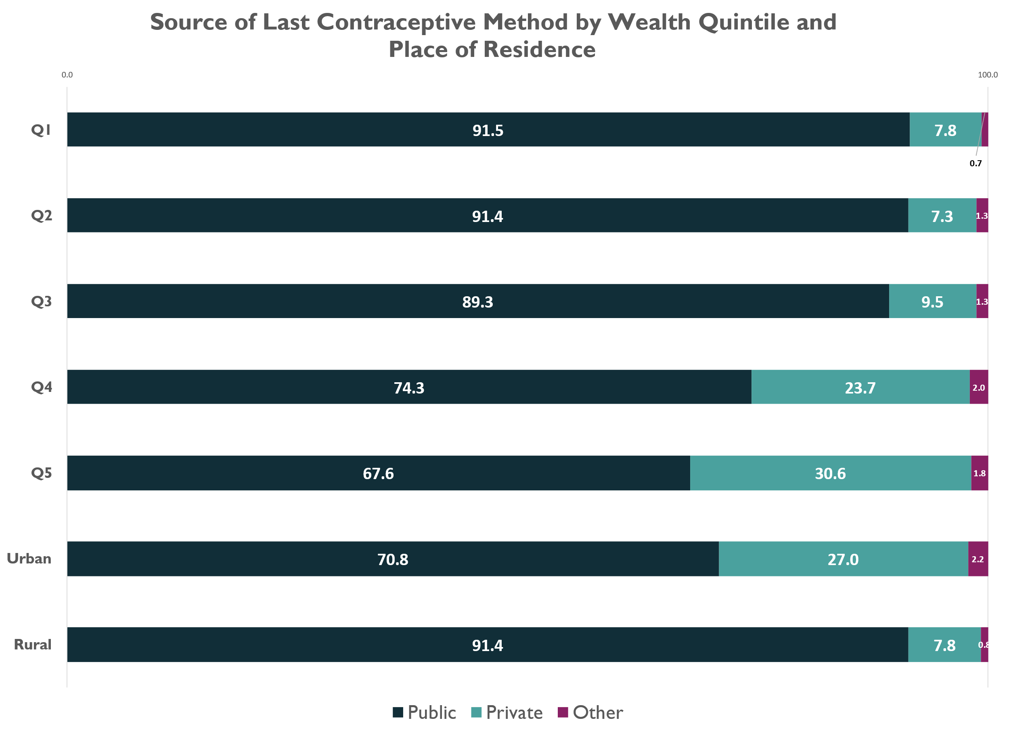
While the public sector is the primary source, urban wealthier women appear promising for greater access in the private sector
The private sector as a source for contraception is most popular among women in the highest two wealth quintiles and among women living in urban areas
Source: SLDHS 2019

Slide 27
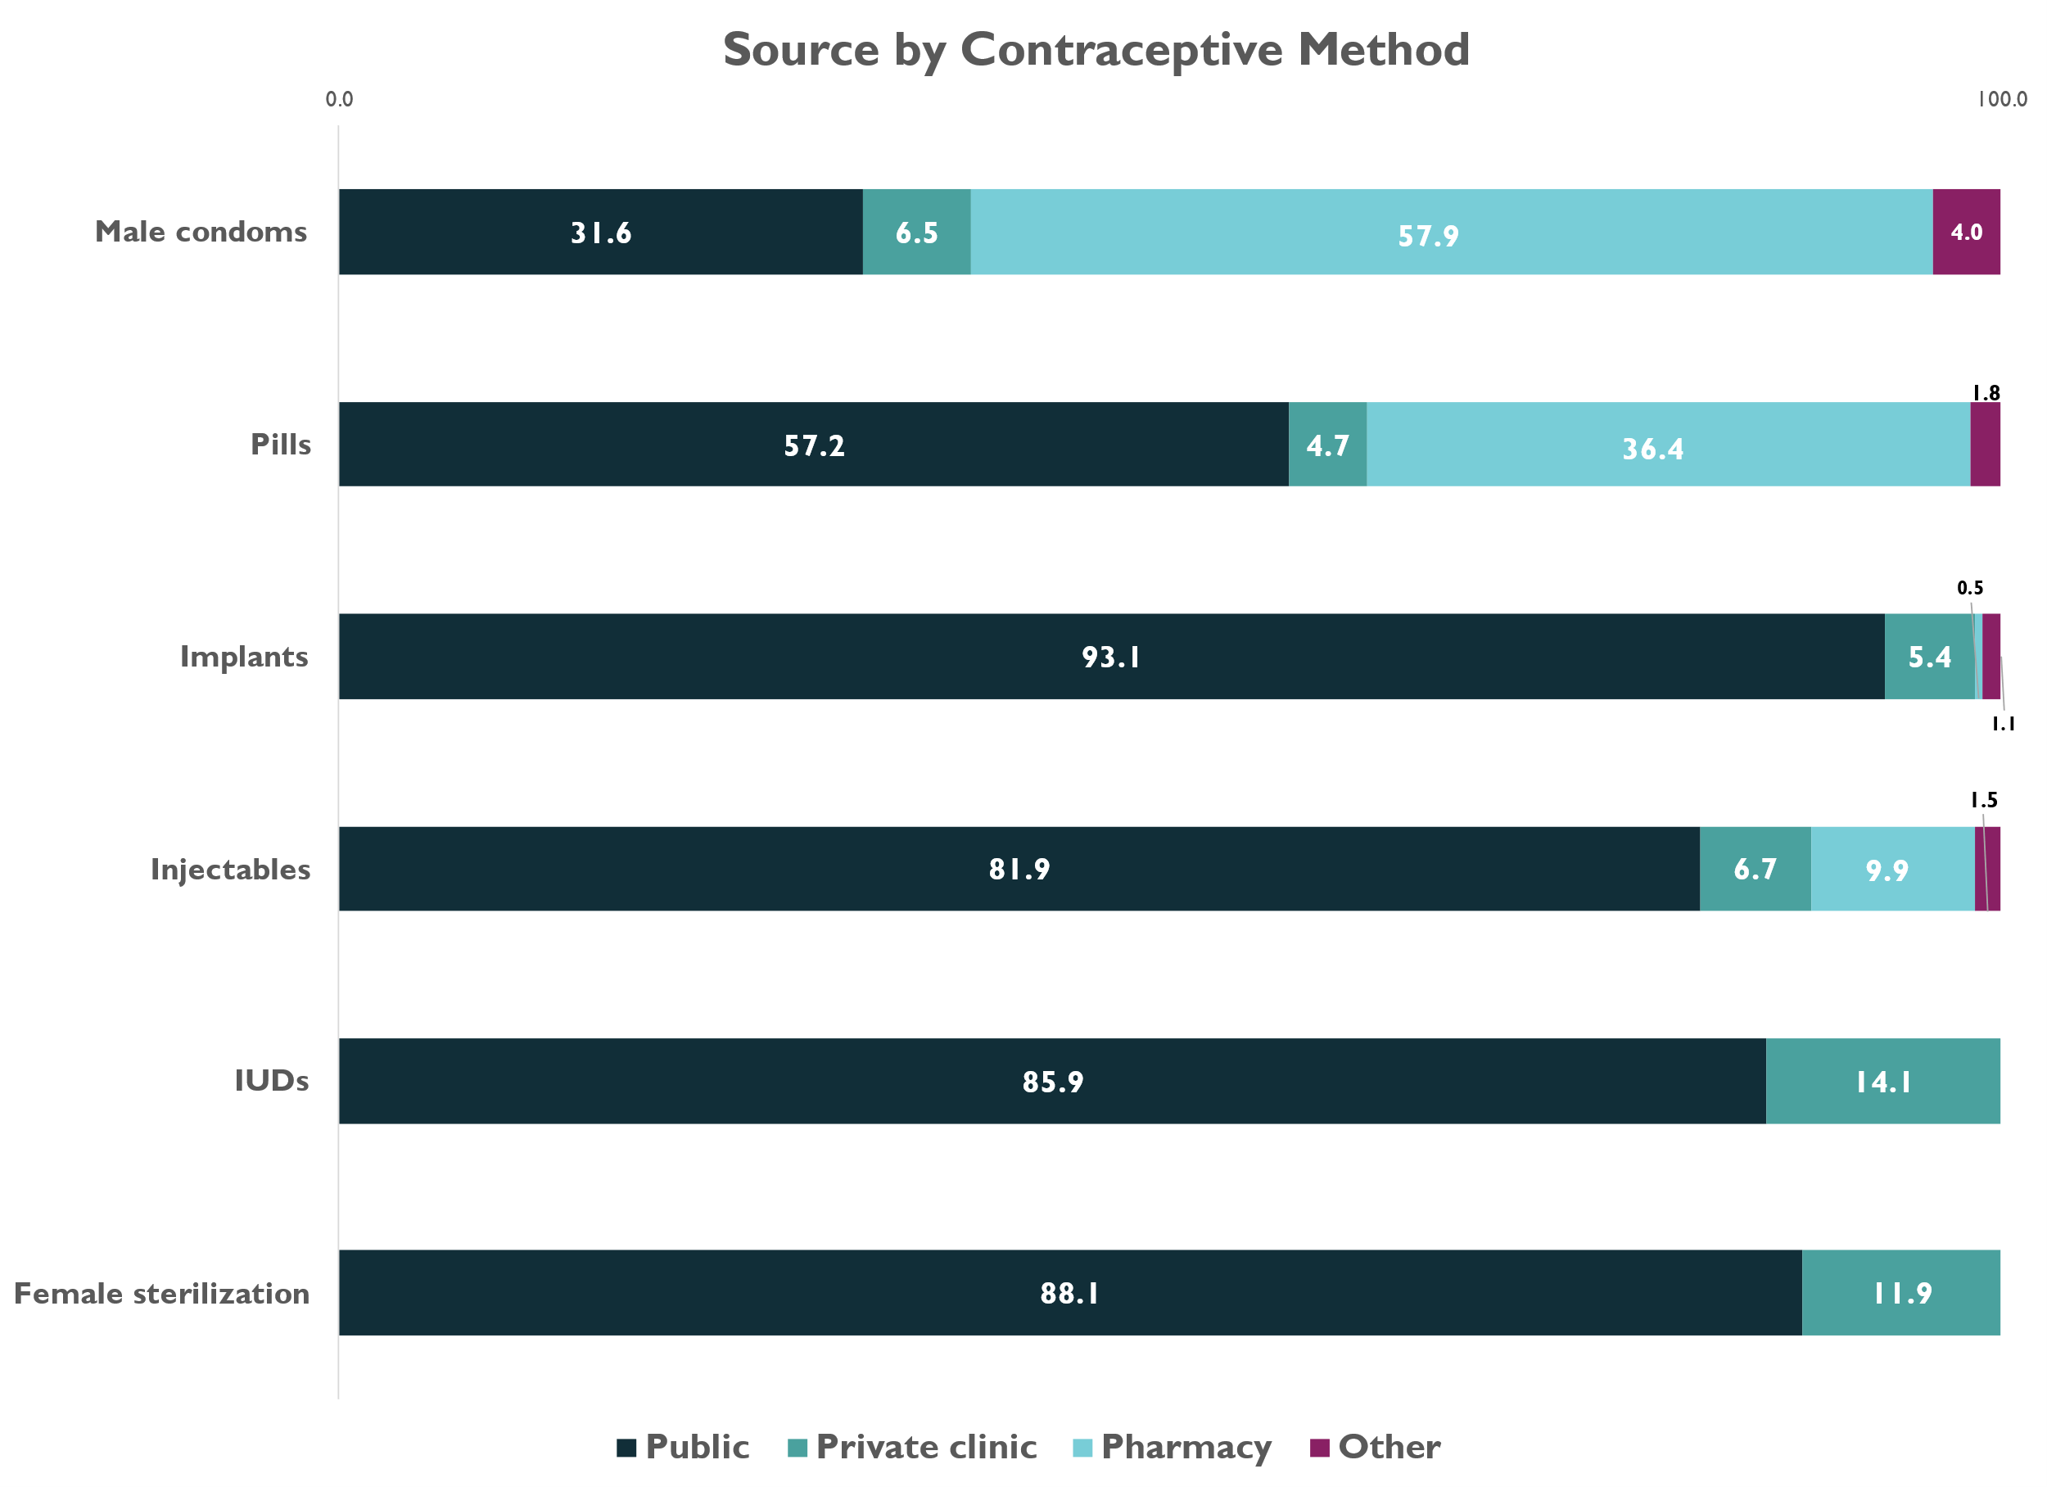
The private sector is utilized most frequently by women to obtain condoms and pills: Nearly 1 in 10 users of injectables went to a pharmacy
Source: SLDHS 2019

Slide 28
Summary | Market Breadth & Depth
Understanding the decline of private sector is essential
Unmarried WRA ages 20-24 access more from the private sector
Low density of key private sector channels, concentrated in the capital, presents an opportunity to shape practices and align incentives to expand access to quality-assured FP commodities
The pharmacy channel is promising, especially for reaching unmarried, urban and higher income women, particularly for condoms, OCPs and injectables
It is essential to understand users' journeys to accessing FP products and services, including their interactions and experiences across several nodes: doctors, patent stores, pharmacies, and private field workers
Early growth phase in short-acting methods is seen for SMOs

Slide 29
04. Supporting Functions: Stewardship, Financing, Rules and Policies
* Preliminary DHS 2022 analysis

Slide 30
Stewardship: Political commitment strong and visible for FP
The Ministry of Health and Sanitation (MoHS) oversees this initiative, emphasizing stewardship and leadership and intends actively to mobilize support and resources from domestic sources, partners, and the private sector.*
The establishment of the National Secretariat for the Reduction of Teenage Pregnancy and the development of the National Strategy for the Reduction of Adolescent Pregnancy and Child Marriage (currently under revision) is also a testament to the government’s commitment.
*Source: Government of Sierra Leone. 2017. Sierra Leone Family Planning Costed Implementation Plan. Freetown: Ministry of Health and Sanitation.
Photo Credit:Annie Spratt, Sierra Leone
Notes:
The key takeaway is that while there is political commitment and high intention, there appears to be an intention-action gap. We will need to understand what concrete actions were taken and learnings, if any.

Slide 31
Sierra Leone's FP 2030 Commitments: Absence of private sector strategies
Government of Sierra Leone by 2027: “We envision a Sierra Leone where everyone is empowered to make informed choices, has affordable and equitable access to quality, rights-based family planning and sexual and reproductive health services and is fully capacitated to participate in national development, leaving no one behind.”
Objective 1: Improved policy and legal environment commitment
Objective 2: Increased access to quality family planning services commitment
Objective 3: Strengthened supply chain commitment
Objective 4: Transformed social and gender norms financial
Objective 5: Sustainable financing for family planning

Slide 32
National Health Insurance Program grapples with low participation
Health Care Financing
Health spending is largely dependent on households and donors
Damaging spillover costs of corruption in the health care system:
Creates inefficiencies in the health care system
It undermines citizens’ trust in public institutions
6.5%
Health as a share of total government spending
$43.21 per capita
Source: World Bank statistics, World Bank 2020 private sector health assessment, Human Resources for Health Strategy 2017-2021​

Slide 33
External Funding for Contraceptives
Funding for Contraceptives by source ($)
Total 2021 $ 4.8 M USD
Government of Sierra Leone
Nil (has committed 1% for FP 20230)
UN
55%
$2.4 million
Other Bilateral
45%
$1.9 million
MoH is not fulfilling its commitment to spend 1% of its revenues on buying contraceptives
Costs and funding for the NGO and FLW ecosystem is not readily available. Recent costed FP budgets, allocation & utilization at a national level not available
UNFPA and bilateral account for 95% of commodity funding. Generally downward trend of donor funding and not adequately supported by private sector investments
Source: 2021 USAID GHSCP CS indicators

Slide 34
Access to FP: Adolescents have high unmet FP need, but legal barriers hinder providers from provision of services
The percentage of teenagers who have given birth or are pregnant with their first child has decreased since 2013 (28%) but is still high at 21%. In most cases, girls who become pregnant end up being married, regardless of their age.
This affirms the fact that marriages are still happening for girls under the minimum age stipulated in the formal law through social and customary arrangements.
Child Rights Act (2007) and the Sexual Offences Act (2012) stipulate that “a person aged under 18 years cannot consent to sex, having sex below this age illegal.”
The Registration of Customary Marriage and Divorce Act (2009) also states that a person can only legally marry if they are over the age of 18 years.
No specific affirmative law or policy exists to support adolescent access to these services without authorization from a parent, spouse or provider
Were there such a law, it would provide the necessary legal basis for a social and behavior change program that could counteract social and traditional norms and customs, which restrict access of young people to FP services
Currently, in the absence of such an affirmative law, health care providers are uncertain about the legal or policy implications of providing family planning services to adolescents under 18
Notes:
Applicable to all users and providers on unintended consequences of bad laws
Child Rights Act (2007) and the Sexual Offences Act (2012) stipulate that “a person aged under 18 years cannot consent to sex, having sex below this age is illegal.” The Registration of Customary Marriage and Divorce Act (2009) also states that a person can only legally marry if they are over the age of 18 years.
Yet: The percentage of teenagers who have given birth or are pregnant with their first child is still high at 21 percent. In most cases, girls who become pregnant end up being married, regardless of their age. This affirms the fact that marriages are still happening for girls under the minimum age stipulated in the formal law through social and customary arrangements.
Hence these Laws have unintended consequences –
No specific affirmative law or policy supports adolescents' access to these services without authorization from a parent, spouse, or provider. (No agency or autonomy on her rights)
Were there such a law, it would provide the necessary legal basis for social, and behavior change programs that could counteract social and traditional norms and customs restricting access for young people to family planning services. Currently, in the absence of such an affirmative law, healthcare providers are uncertain about the legal or policy implications of providing family planning services to adolescents under 18.
(The pvt sector doesn’t want great laws to thrive but one bad one is enough to dampen their enthusiasm as these laws lead to harassment and corruption)

Slide 35
Access to FP: In addition to the low density of the health workforce, restrictions exist on who can provide which FP services
Service providers (limited number and scope of work): Community health workers (CHWs) are limited in the family planning methods they can offer clients. Currently, they can provide only condoms and refills of contraceptive pills
Adolescents and young people face unnecessary medical and administrative hurdles, including notification or consent requirements, which hinder their access to essential services. These barriers indicate an underlying cultural barrier that complicates their ability to receive timely and confidential care, ultimately impacting their health and well-being. Addressing these issues requires revising policies to eliminate these obstacles and ensure that young individuals can access the services they need without undue restrictions or risk of punitive action
Photo Credit: UNFPA Sierra Leone

Slide 36
Type of Channels and FP Provision Opportunities for task shifting/sharing with nurses and CHWs
Sector | Channel type | FP methods currently allowed
Public sector | Hospital | SAM, LARC, permanent methods
 | Health centers | SAM,LARC
 | Nurses/midwives | SAM,LARC
 | Community health workers | Condoms, OCPs
Private sector | Patent stores | Condoms, OCPs, EC
 | Pharmacies | Condoms, OCPs, EC and DMPA
 | Qualified doctors (private clinic) | SAM, LARC, permanent methods
 | Private community health workers | Condoms, OCPs
SAM: Short Acting Methods
LARC: Long-Acting Reversible Methods
OCP: Oral Contraceptive Pills
DMPA: Depo-medroxyprogesterone acetate
EC: Emergency Contraceptives

Slide 37
Summary | Stewardship
Adolescent and youth reproductive health should be the focus
Create a public-private platform and engage private sector constructively
Translate MoHS aims in the “National Strategy for the Reduction of Adolescent Pregnancy and Child Marriage” into implementable policies and guidelines and remove restrictive administrative and legal barriers for youth access to FP
Take steps to create a self-care strategy and allow an expanded range of FP service provision from diverse providers, including pharmacies. Clarify and roll out guidelines on which type of private sector channel can provide what type of services for youth
Develop and adopt a segmented strategy for youth-driven demand and encourage SMO/private sector actors to address adolescents’ needs for FP

Slide 38
05. Market Constraints
A summary of key constraints identified, by market function, using the AIM framework

Slide 39
Key market constraints: Core market AIM analysis for market system performance in Sierra Leone
Market characters |  | A Absent | I Inadequate | M Missing | Observations
Core Market | Supply |  |  | X | There is a mismatch between supply and adolescent/youth needs. The mismatch is across method, point-of-service, sales, and information provision. All contraceptives distributed through the public sector are donated and in 2022 NMSA reported stock outs incidences 61% when measured. All private sector commodities are imported and time to indent and distribute is 180 days. While private sector stockouts were not measured, choice of methods is constrained in public sector. Getting commodities to the last mile is a real challenge for the private sector, which is concentrated in urban areas. An estimated 50% are in Freetown, the capital city.
 | Demand | X |  |  | Demand appears to be led by supply: Based on what is available rather than what a user needs and may prefer. There is no evidence of consistent FP communications across media channels. Branded communication is absent. CHWs who create demand as front-line workers are restricted to the provision of only condoms and pills which limits expanded choice to meet user needs.

Slide 40
Key Market Constraints: Supporting functions AIM analysis for market system performance for Sierra Leone
Market characters |  |  | A Absent | I Inadequate | M Missing | Observations
Supporting Functions | Financing | S & D |  |  | X | There is little information about the promotion or marketing of FP and associated costs. It appears that radio is a medium that reaches the young. Costs and funding information for the FLW/NGO ecosystem is missing Private sector suppliers indicate low margins to undertake marketing or point of sale advertisements Main source of information on contraception is word of mouth: Young people discuss sex and contraception with their peers, people who are close to them and whom they trust (and from the ones who don’t have the correct information)
 |  | Subsidies |  | X |  | MoH is not fulfilling its commitment to spend 1% of its revenues on buying contraceptives. UNFPA and bilateral account for 95% of commodity funding Generally downward trend of donor funding and not adequately supported by private sector investments
 |  | Business | X |  |  | Importers and distributors depend on SMO or public procurement. Currently no incentives to expand portfolio and invest in market creation in urban areas for SAM Import of Durex in 2022-2023 appears to be a promising development as a proxy. Similarly, sales of EC and Miso with combi kits indicate a developing market Access to formal financing remains restricted for importers and distributors due to poor forecasting, and long cash flow cycles

Slide 41
Key Market Constraints: Supporting functions AIM analysis for market system performance for Sierra Leone
Market characters |  |  | A Absent | I Inadequate | M Missing | Observations
Supporting Functions | Info | Supply | X |  |  | RHSC import data, DKT sales stats and GHSPSM CS indicators must be used to estimate a range No formal market intelligence and the last costed implementation plan in 2017 projected demand-based supply estimates which have not come to fruition No forecasting system that accounts for a deep understanding of what user needs are and there are information blind spots on the private sector supply chain
 |  | Demand | X |  |  | Completely absent. Given DHS 2022 is now available, there is an opportunity to provide better estimates to inform national strategies
 | Skills, Capacity |  |  |  | X | Lack of confidentiality at health providers’ facilities Health personnel training, Personnel turnover, and deployment to other regions discourage investments in training which are of long duration (10 to 21 days) Healthcare professional associations are not prominent or influential enough
 | Stewardship |  | X |  |  | High political commitment but weak or absent follow-through There is a lack of urgency to transition to a segmented FP stewardship across sectors. Decreasing donor funding is an imminent challenge

Slide 42
Key market constraints: Rules & Regulations AIM analysis for market system performance for Sierra Leone
Market characters |  |  | A Absent | I Inadequate | M Missing | Observations
Rules and Regulations | Regulations |  |  |  | X | Barriers through Legal rules on child marriage and age of consent prevents supply chain and solution providers from fearlessly providing services to adolescents Community Health Workers (CHWs) are limited by what family planning methods they can offer clients. Currently, they can only provide condoms and refills of contraceptive pills Unnecessary medical and administrative barriers from Ministry of Health and Sanitation (MoH&S) guidelines, such as notification or consent requirements for adolescents and young people
 | Tariffs, Taxes |  |  |  | X | The government has been supportive in terms of obtaining duty waivers, but sometimes lack of clarity of how to clear products from customs / lack of support
 | Standards |  | X |  |  | There is a department of Pharmaceuticals that looks exclusively at licensing. Absence of clear standards and pharmacovigilance. No monitoring of the quality of products and quality of services provided in pharmacies
 | Norms | Supply |  |  | X | Importing, selling commodities, or operating as a private health provider requires contacting multiple government offices and multiplying red tape, making it a restrictive process
 |  | Demand |  |  | X | Some censorship around contraception / FP communication. Misalignment with stated objectives of increasing use with underserved populations with high unmet need

Slide 43
Recommendation 1: Focus on underserved market segments
Target market segments: Develop strategies to better serve adolescent girls, young women, unmarried women, and women in lower wealth quintiles
AYSRH priority: Prioritize Adolescent and Youth Sexual and Reproductive Health (AYSRH) in national stewardship and market development approach strategies to ensure comprehensive and inclusive access to services for these underserved groups

Slide 44
Recommendation 2: Align supply with adolescent and youth needs
Address the mismatch between supply and the needs of adolescents and youth across methods, points-of-service, sales, and information provision to ensure their requirements are met effectively
Ensure reliable contraceptive supply: Improve the reliability of contraceptive supply and expand access in rural areas: Tackle the challenge of delivering commodities to the last mile, especially in rural areas. Develop strategies to extend private sector reach beyond urban centers
Understand private sector dynamics: Investigate the reasons behind the decline in the private sector's performance. Recognize that unmarried women of reproductive age (WRA) aged 20-24 rely more on the private sector for access
Leverage pharmacy channels: Utilize the pharmacy channel to reach unmarried, urban, and higher-income women, particularly for condoms, oral contraceptive pills (OCPs), and injectables. This channel shows promise for expanding access to FP commodities
Enhance user experience: Understand the user journey for accessing FP products and services by analyzing interactions and experiences across various nodes such as doctors, patent stores, pharmacies, and private field workers. This will help in tailoring services to user needs
Promote short-acting methods: Support the early growth phase in short-acting methods seen for social marketing organizations (SMOs). This can help in expanding the range of choices available to users

Slide 45
Recommendation 3: Understand demand side barriers and address non-use of modern methods
Conduct research to better understand behaviors related to lactational amenorrhea and other traditional methods. Work to improve norms and acceptance, addressing opposition from partners to facilitate the adoption of modern FP methods
Support and manage method discontinuation: Develop strategies to address the support and management of side effects associated with FP methods. Increase knowledge and set realistic expectations around different methods at various stages of life to reduce discontinuation rates
Align supply with user needs and preferences: Transition from a supply-led approach to a demand-driven model. Focus on understanding and meeting the specific needs and preferences of users to ensure they have access to the most appropriate FP methods
Enhance FP communication across media channels: Develop and implement a consistent FP communication strategy across various media channels. Incorporate branded communication to increase awareness and engagement with FP services
Support private sector marketing efforts: Address the issue of low margins for private sector suppliers to enable them to undertake marketing and point-of-sale advertisements effectively
Leverage trusted information sources: Recognize that word of mouth is a primary source of contraception information among young people. Develop strategies to ensure that peers and trusted individuals have accurate information to share

Slide 46
Recommendation 4: Enhance financing support for private sector involvement in family planning
Fulfill government commitments: Ensure that the Ministry of Health (MoH) fulfills its commitment to spend 1% of its revenues on purchasing contraceptives to reduce reliance on donor funding
Diversify funding sources: Mitigate the downward trend in donor funding by encouraging private sector investments in FP commodities. Reduce dependence on UNFPA and bilateral funding, which currently account for 95% of commodity funding
Promote market creation: Create incentives for importers and distributors to expand their portfolios and invest in market creation, especially in rural areas for short-acting methods (SAM). Encourage initiatives like the import, sales of condoms, OCPs, EC, and which indicate a developing market
Improve access to formal financing: Facilitate access to formal financing for importers and distributors by improving forecasting and managing cash flow cycles. Address these financial constraints to enable better market participation and growth

Slide 47
Recommendation 5: Improve market intelligence for catalyzing private sector investments and participation
Develop formal market intelligence systems: Establish a formal market intelligence system to replace the outdated sales data and import data triangulation for private sector. This system should provide better insights into market dynamics and project demand-based supply estimates that reflect current realities. Specifically, this should incorporate a deep understanding of user needs and preferences. This system should address information blind spots in the private sector supply chain to ensure comprehensive market coverage
Leverage new data for better estimates: Utilize the recently available DHS 2022 data to provide better estimates that can inform and shape national strategies. This presents an opportunity to update and improve market intelligence
Bridge information gaps: Identify and bridge information gaps in the private sector supply chain. Collect and analyze data to gain a clearer picture of supply and demand, enabling better decision-making and resource allocation

Slide 48
Recommendation 6: Establish and strengthen stewardship for AYSRH and private sector engagement
Enhance the focus on adolescents and youth reproductive health, engage the private sector effectively, and create actionable policies and guidelines to improve access to FP for young people
Prioritize adolescents and youth reproductive health: Focus on adolescent and youth reproductive health (AYRH) as a key area for development and intervention
Create a public-private platform: Establish a public-private platform to engage the private sector constructively in addressing reproductive health challenges
Translate National Strategy into action: Implement the intentions outlined in the “National Strategy for the Reduction of Adolescent Pregnancy and Child Marriage” by developing policies and guidelines that remove restrictive administrative and legal barriers for youth access to family planning
Develop a self-care strategy: Assist MoHS to develop a self-care strategy that allows an expanded range of FP service provision by diverse providers, including pharmacies. Clarify and disseminate guidelines on the types of FP services different private sector channels can offer to youth
Adopt a segmented strategy for youth demand: Develop and implement a segmented strategy to drive youth demand for FP. Encourage social marketing organizations (SMOs) and private sector actors to address the specific needs of adolescents in accessing FP services

Slide 49
FHM-SIERRALEONE@fhm-engage.org

